Slide 2
On the website, an example of dataviz on the members of the French Parliament - by the Alter Eco data lab
https://www.alternatives-economiques.fr/radiographie-deputes-0607201885508.html

Slide 3
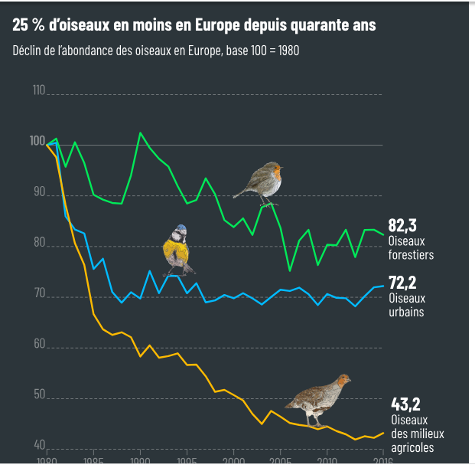
Graphorama, a weekly selection of 4 infographics by the newsroom
https://www.alternatives-economiques.fr/lon-nentend-plus-oiseaux-chanter-printemps-3-autres-infogra/00107020
https://www.alternatives-economiques.fr/salaires-rattrapent-presque-linflation-3-autres-infographies-a-ne/00107158

Slide 4
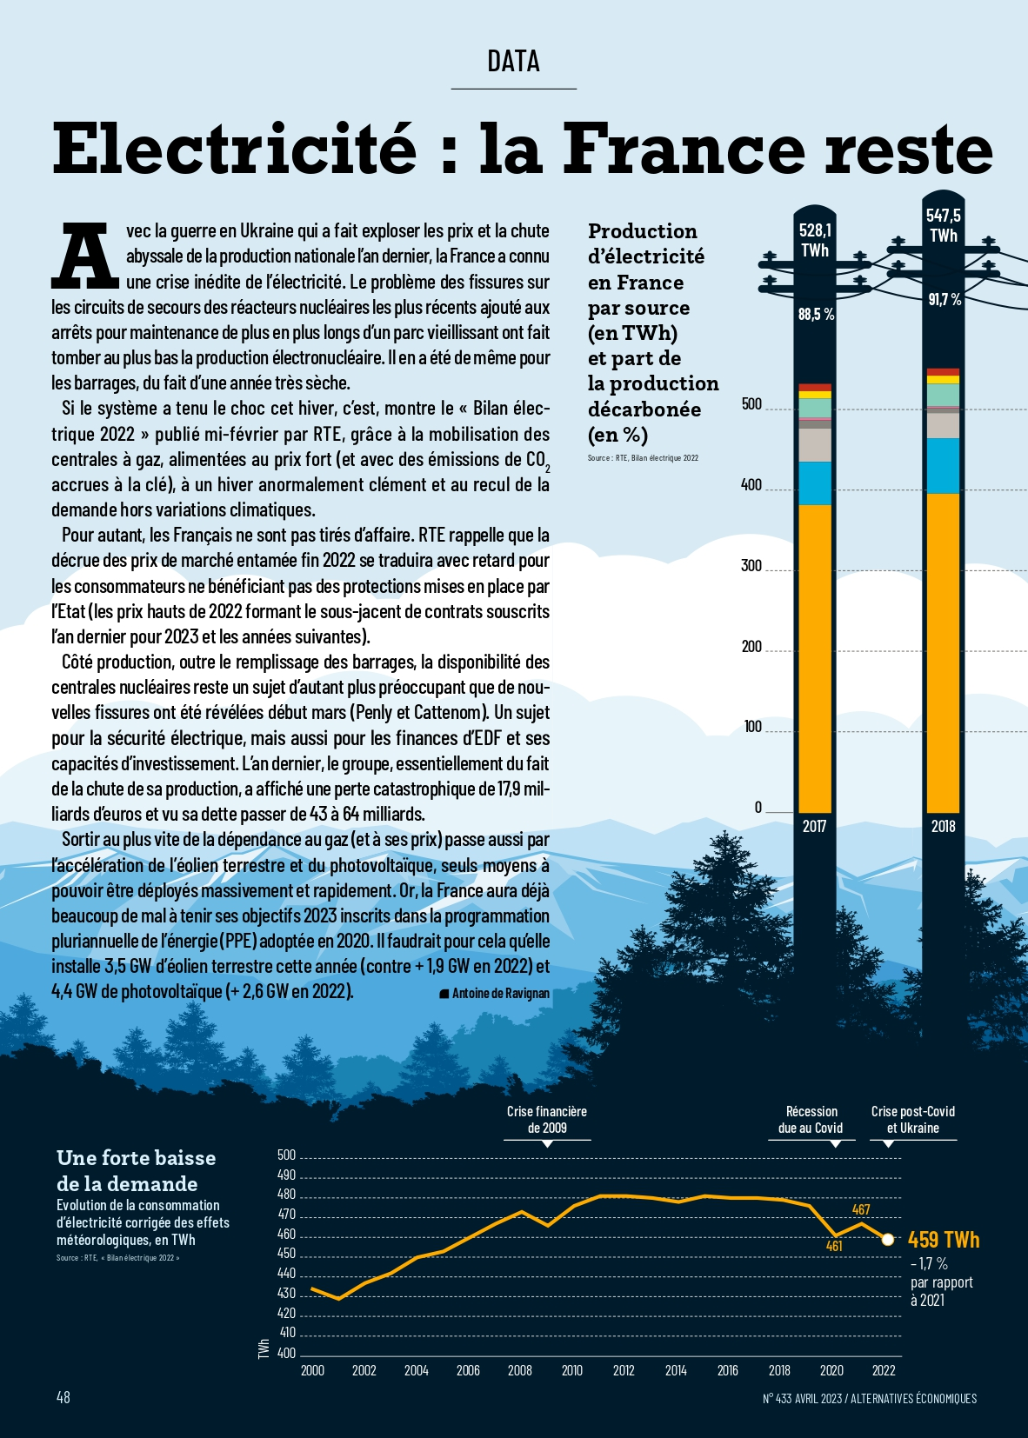
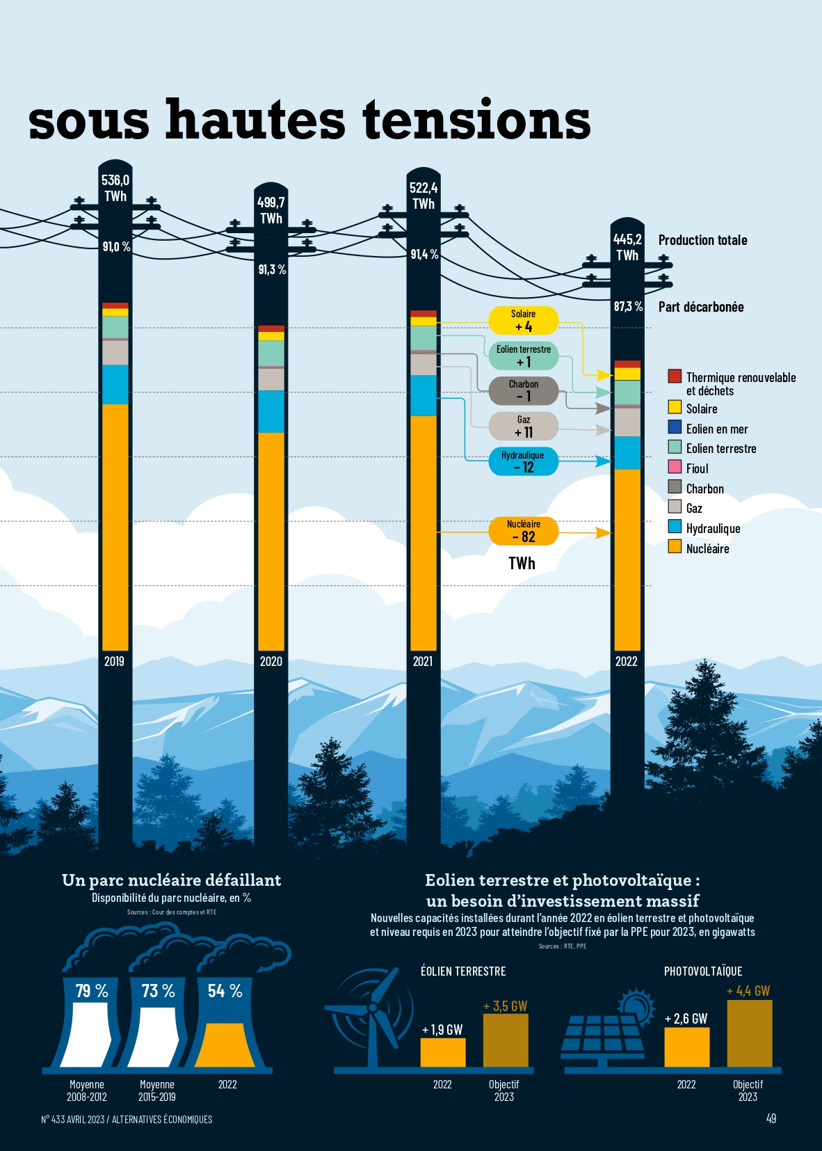
Electricity crisis since Ukraine’s invasion (data section on print)

Slide 5
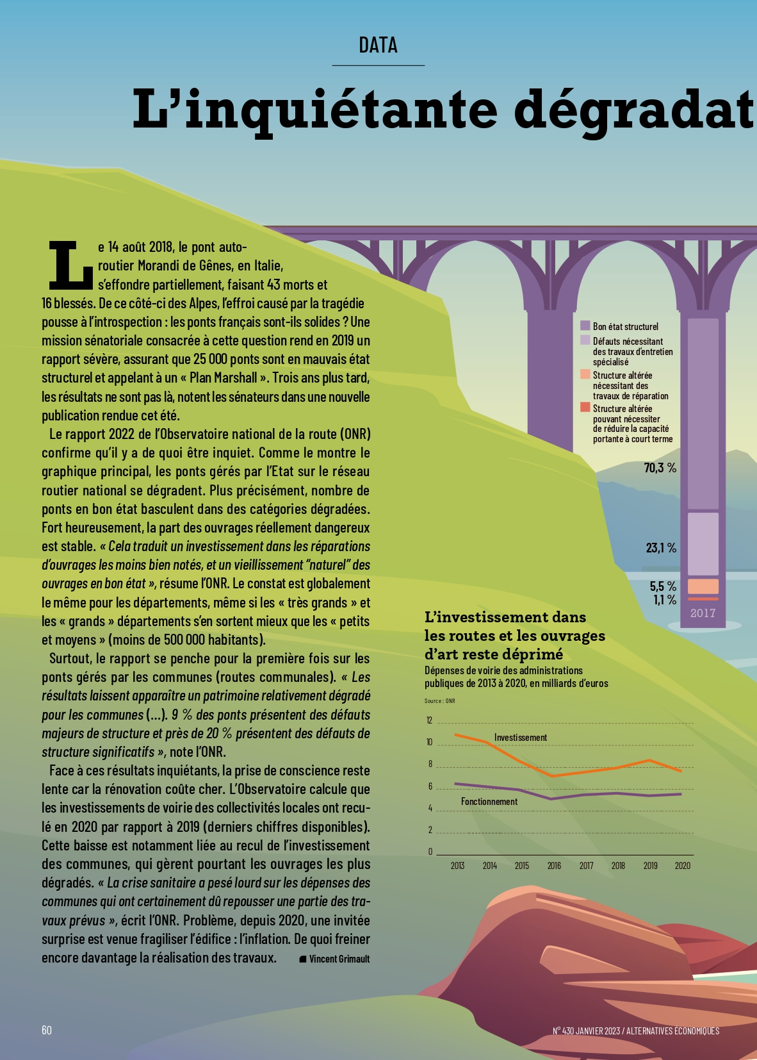
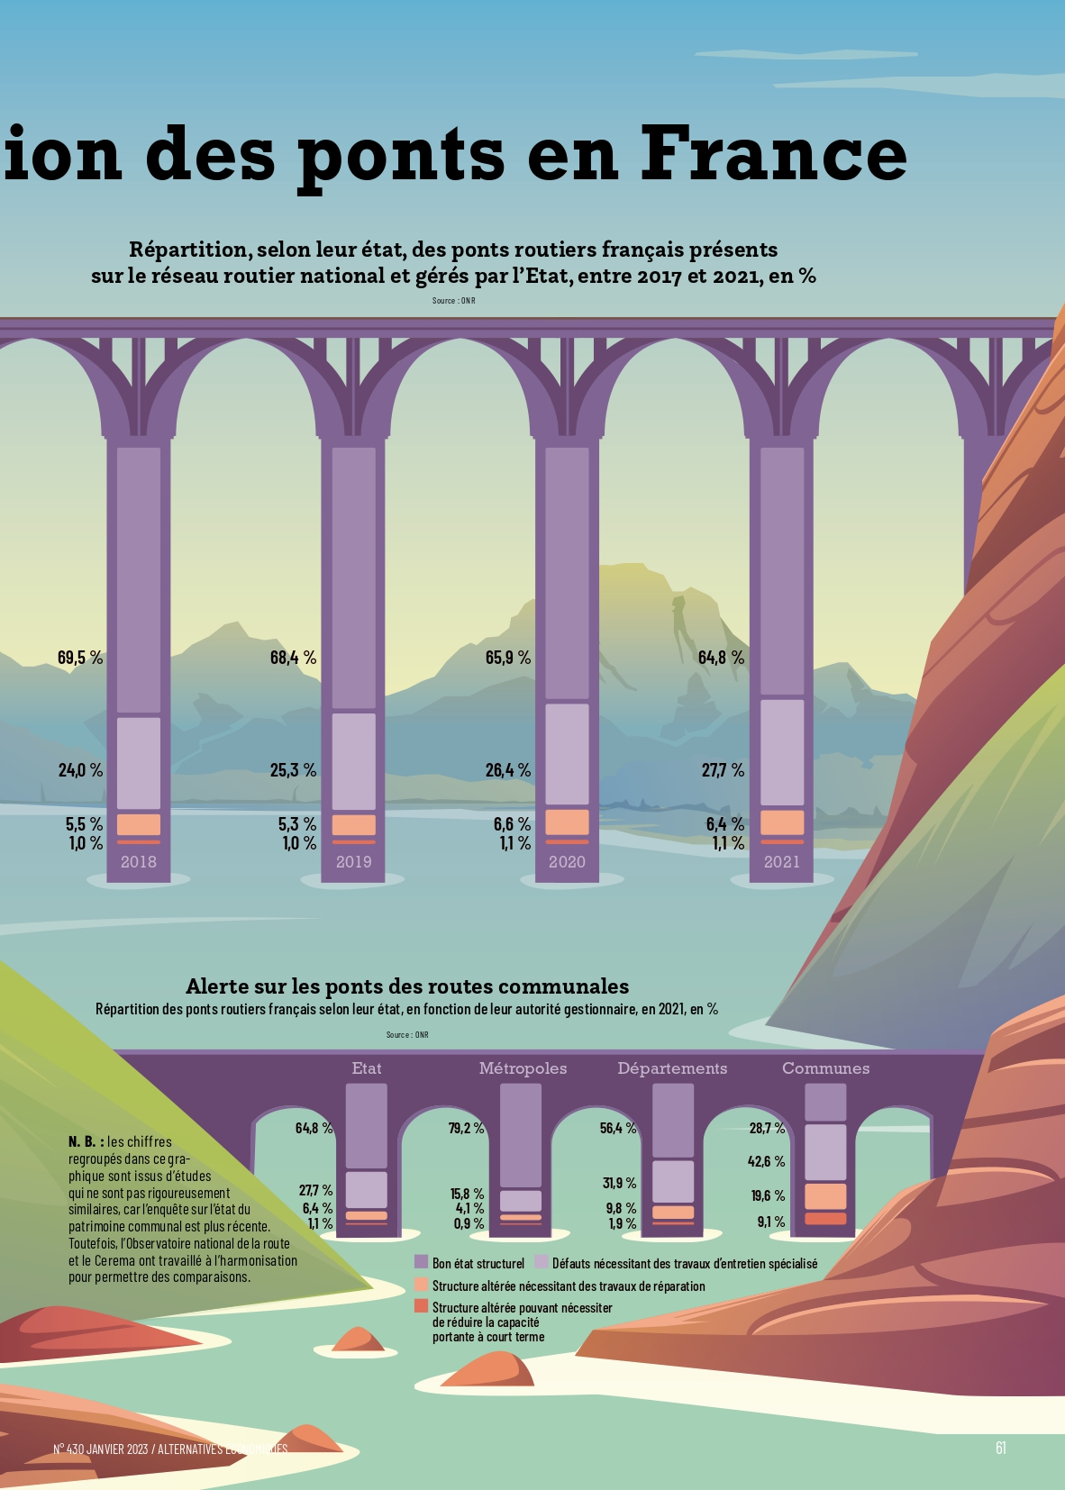
Data on bridge security (print)

Slide 6
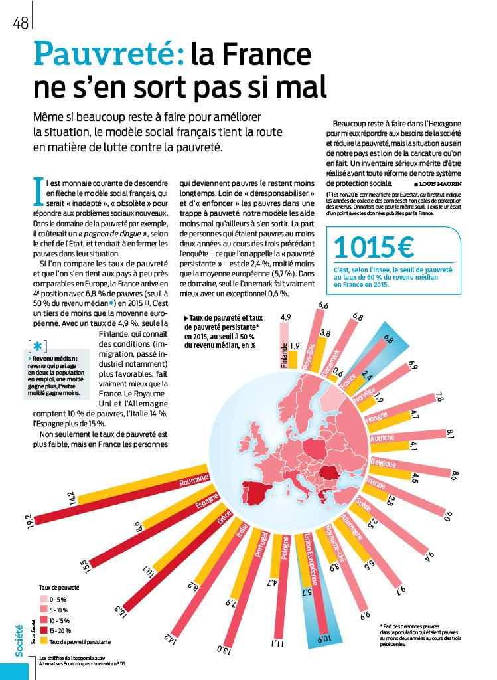
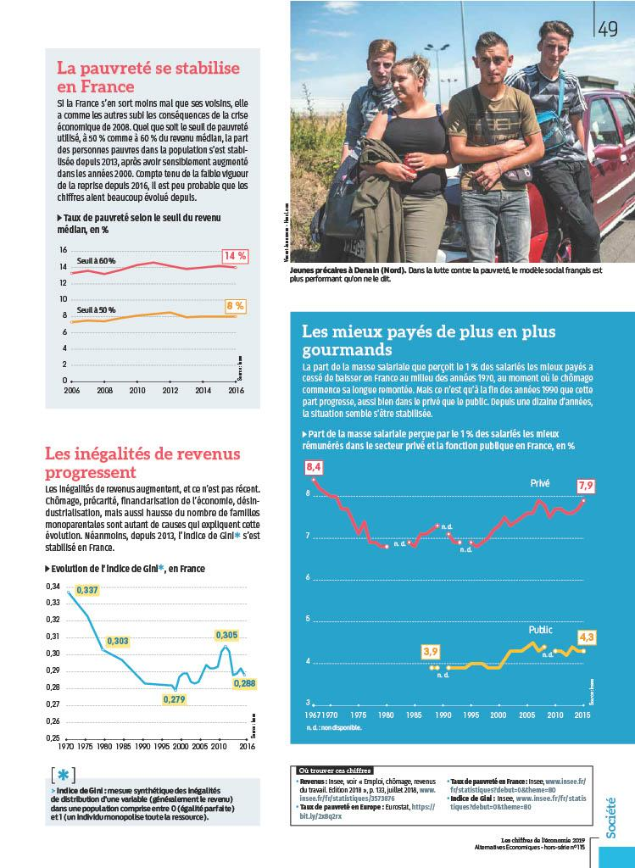
Poverty : the French social model is resisting (hors-série)
Notes:
Les Chiffres de l’économie

Slide 7
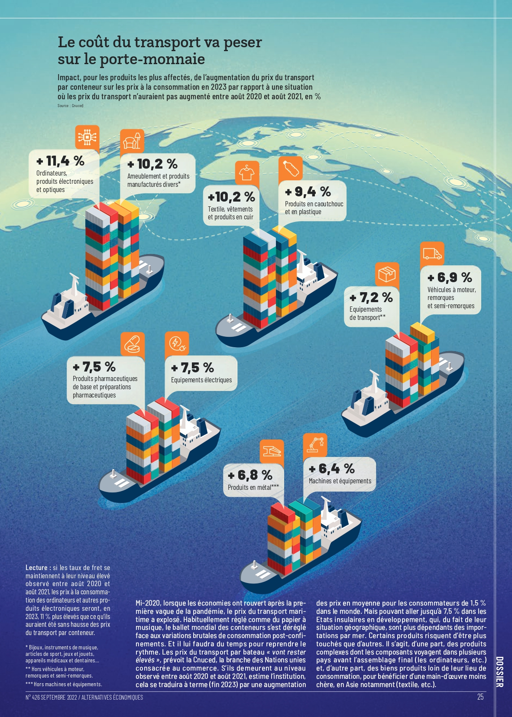
Rise of transportation costs (inflation special September issue)

Slide 8
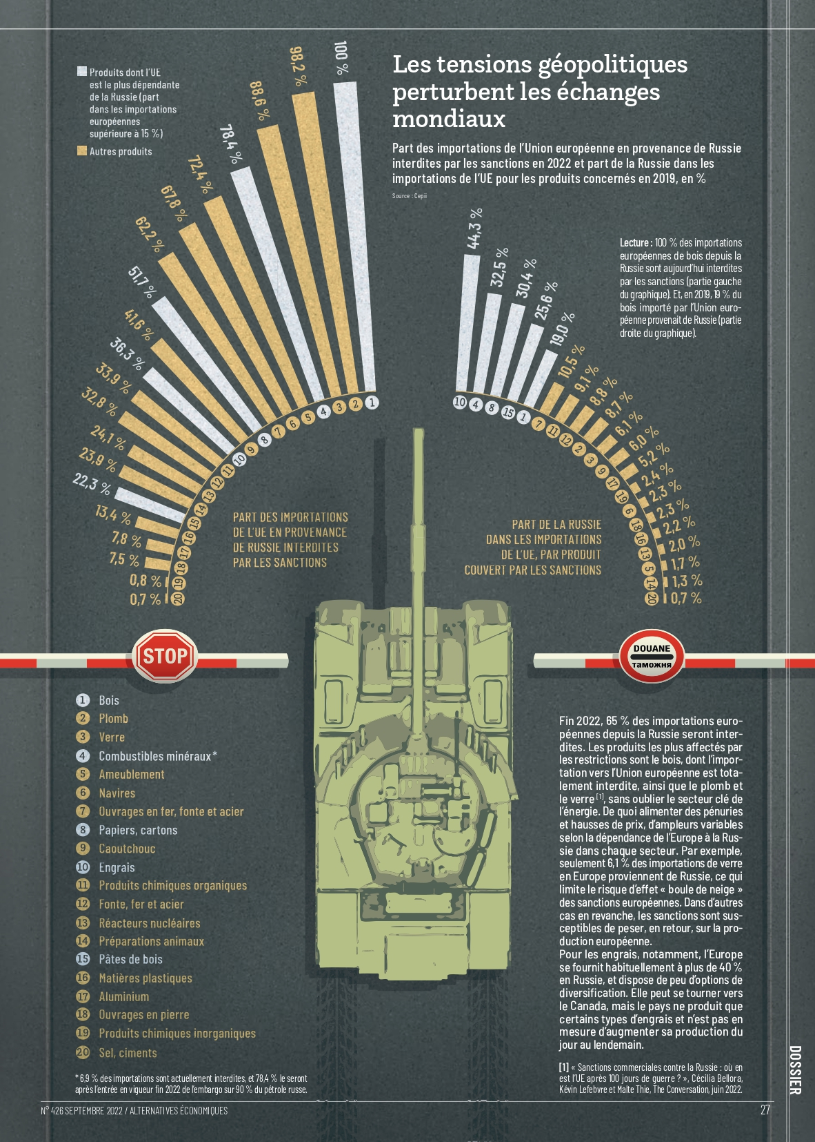
Geopolitical tensions and world commercial exchanges

Slide 9
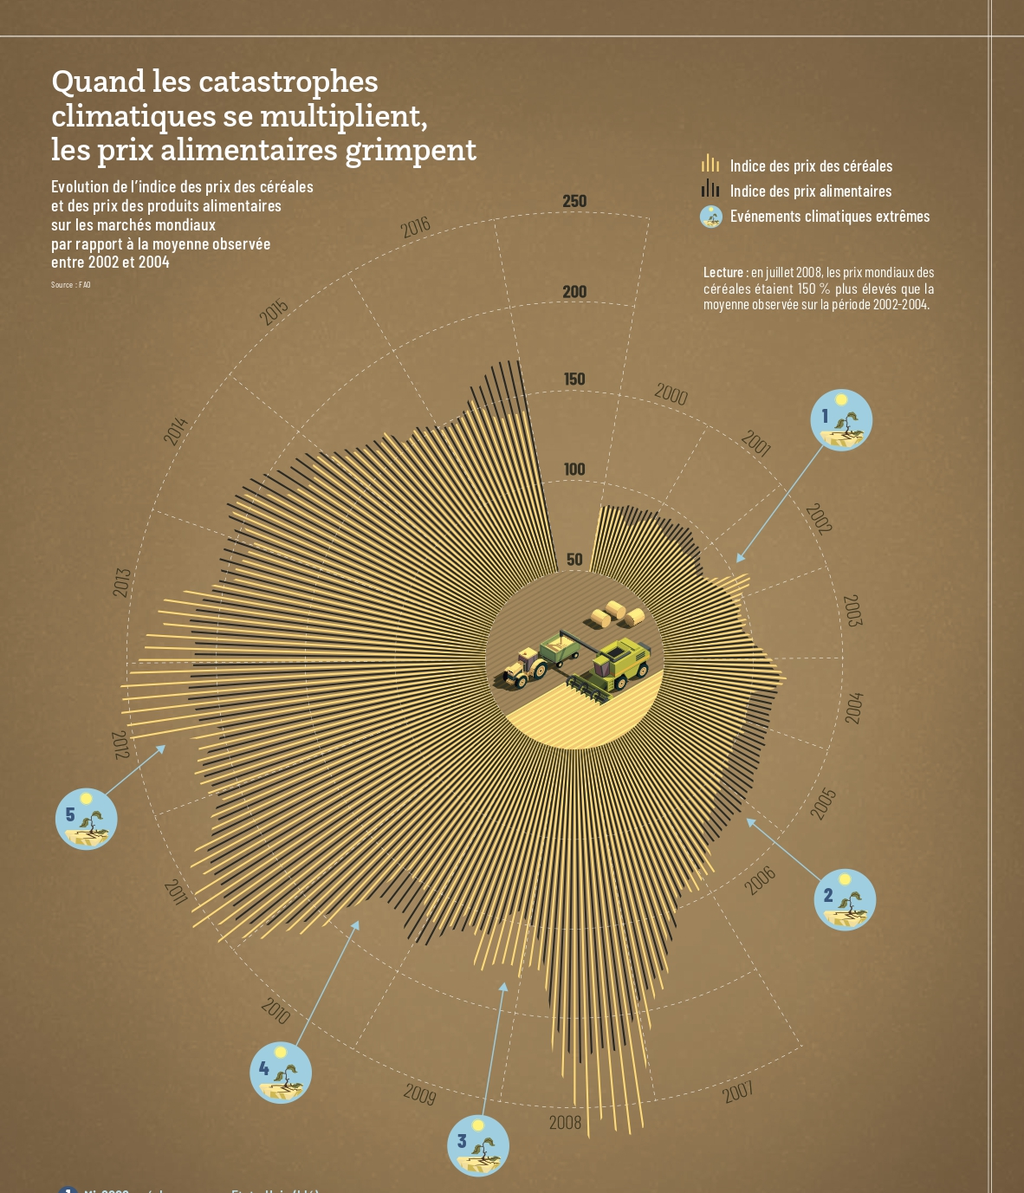
Climate crisis and rise of food prices (inflation special issue)

Slide 10
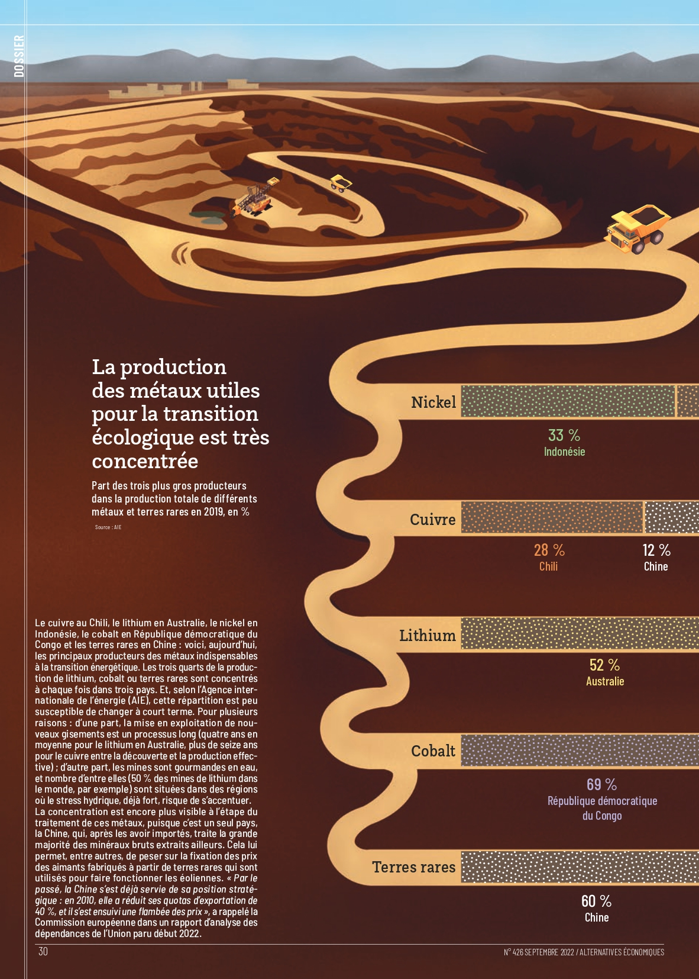
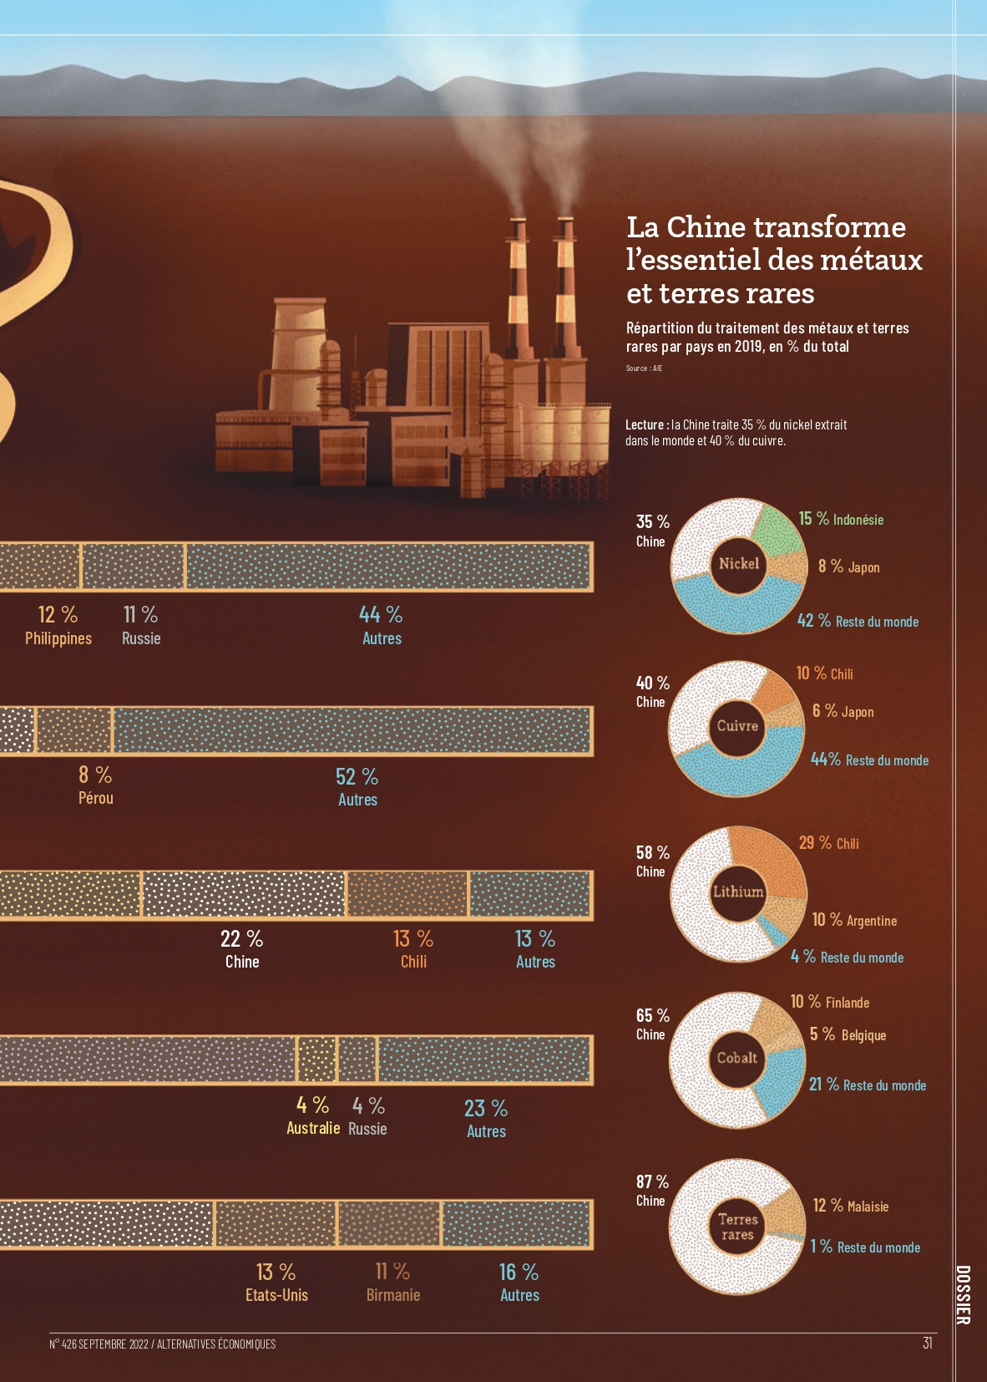
Production of rare earths and metals for ecological transition

Slide 11
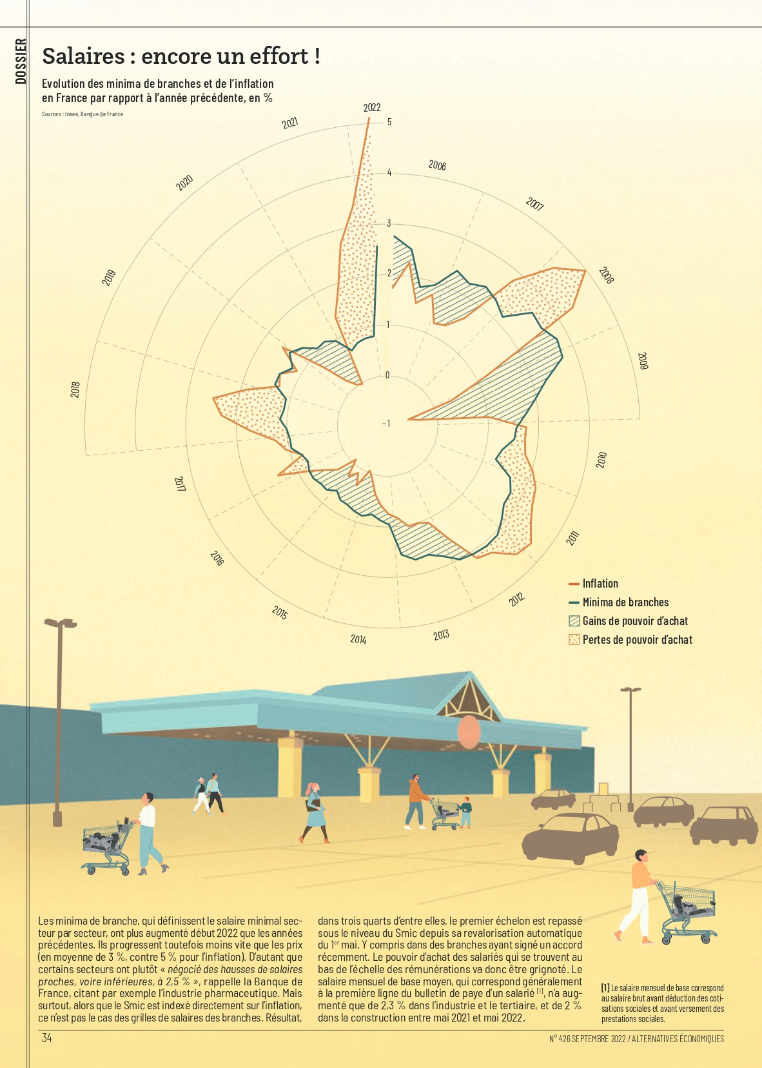
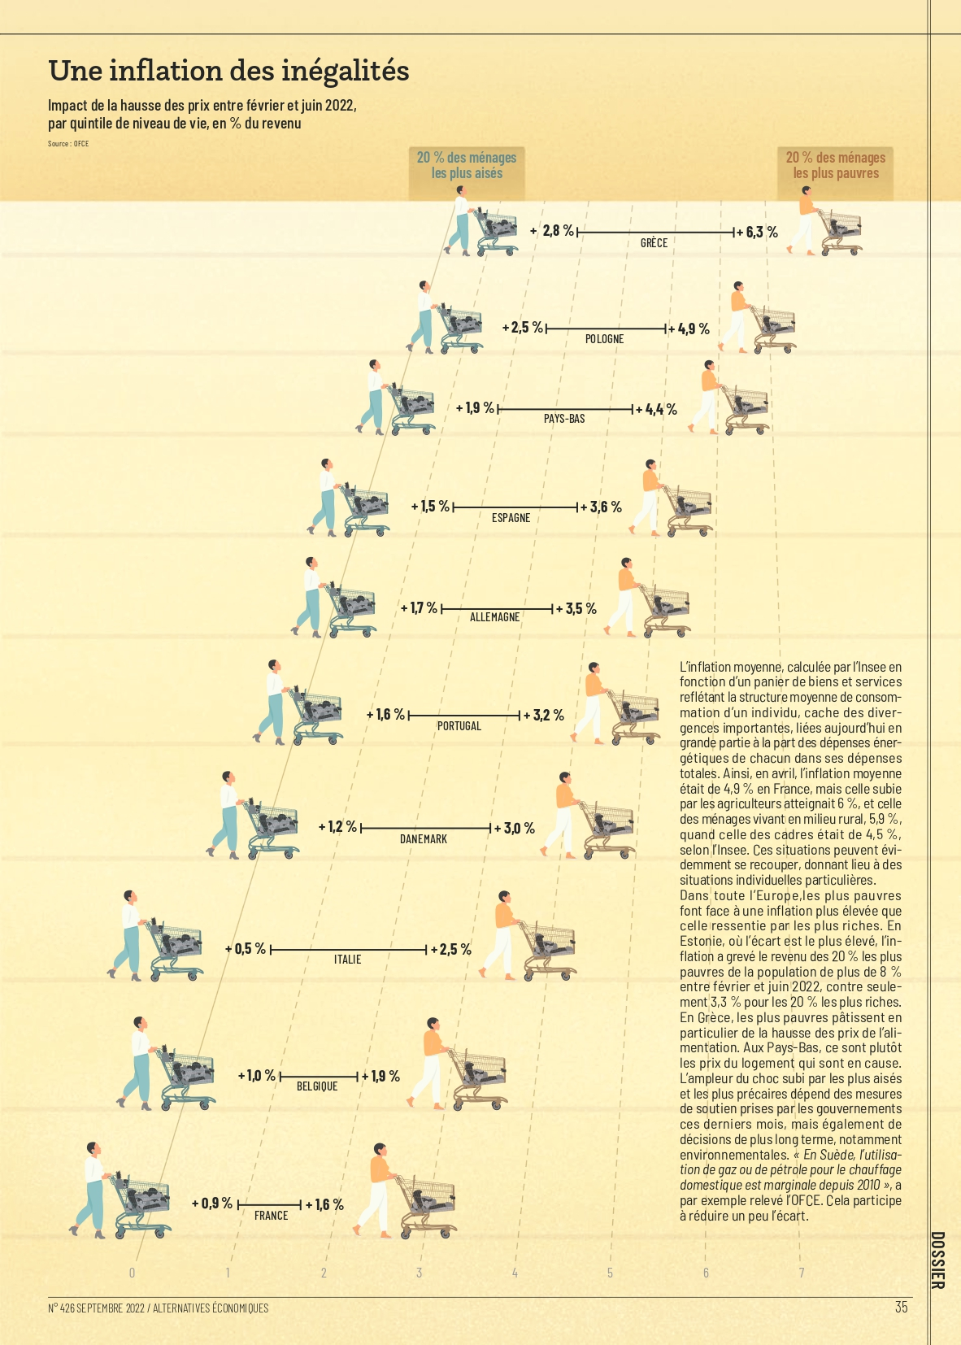
Special issue on inflation : wages & rise of inequalities

Slide 12
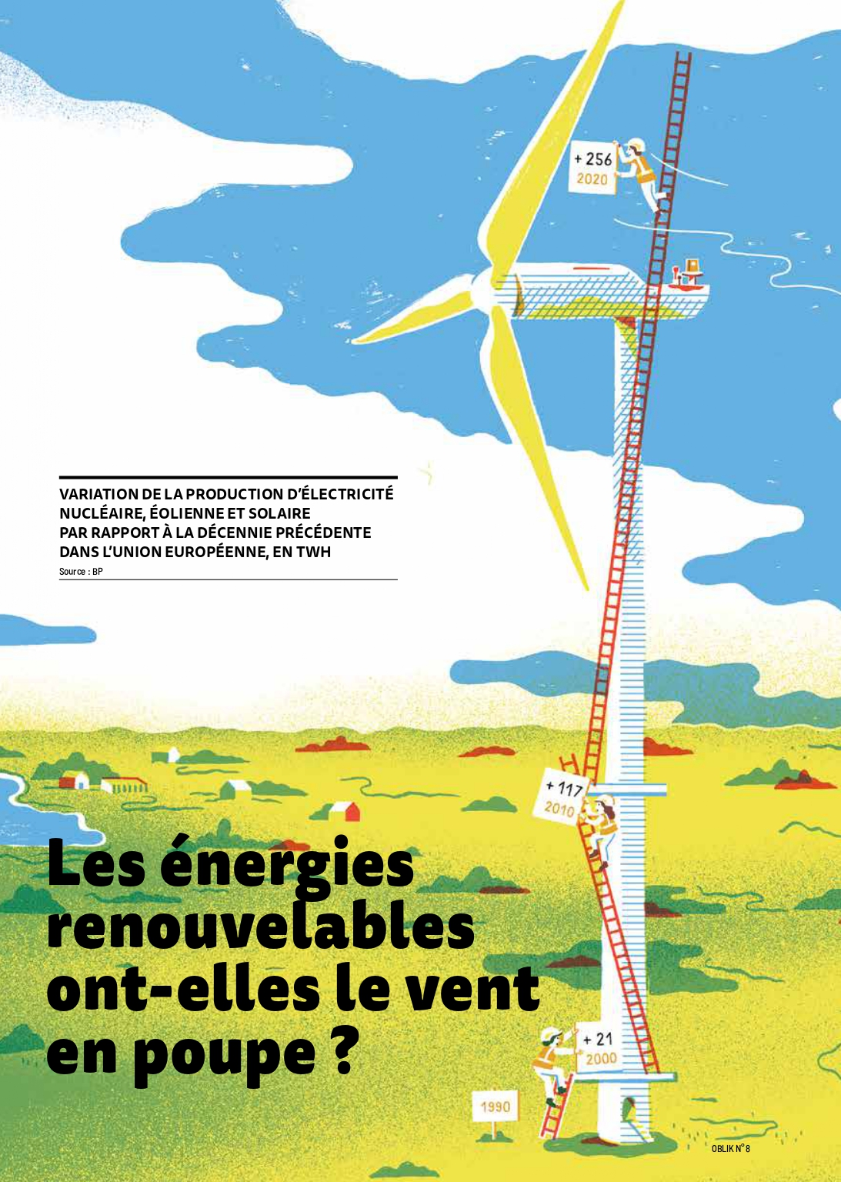
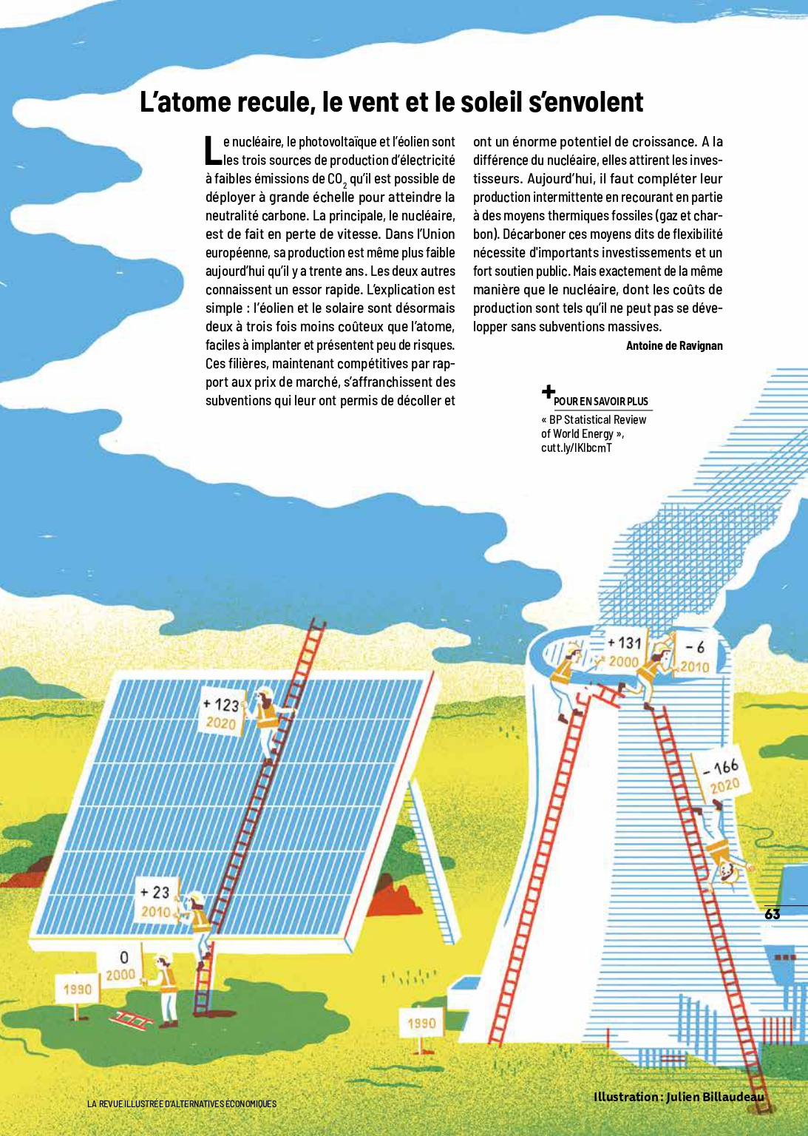
Renewable energies : an example of illustration (Oblik)

Slide 13
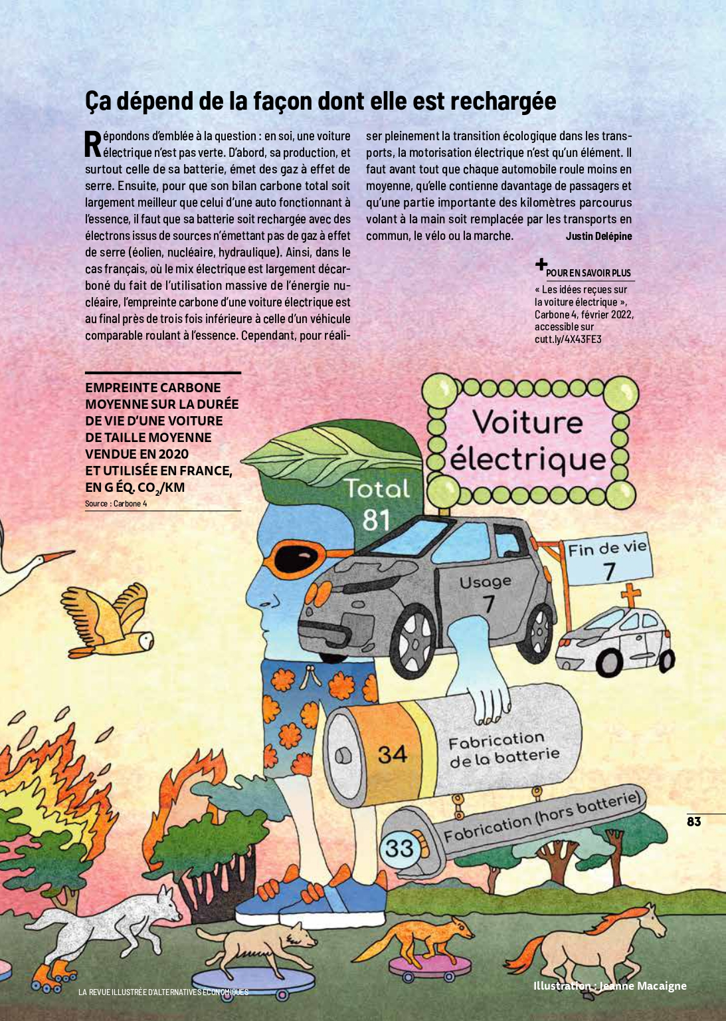
Is the electric car really green ? (Oblik)

Slide 14
Is organic food good for the climate ? (Oblik)

Slide 15
And a daily playmobile version of the news on TikTok, by Rudy…
https://www.tiktok.com/@alter_eco/video/7195633081435409669?lang=fr

