Slide 1
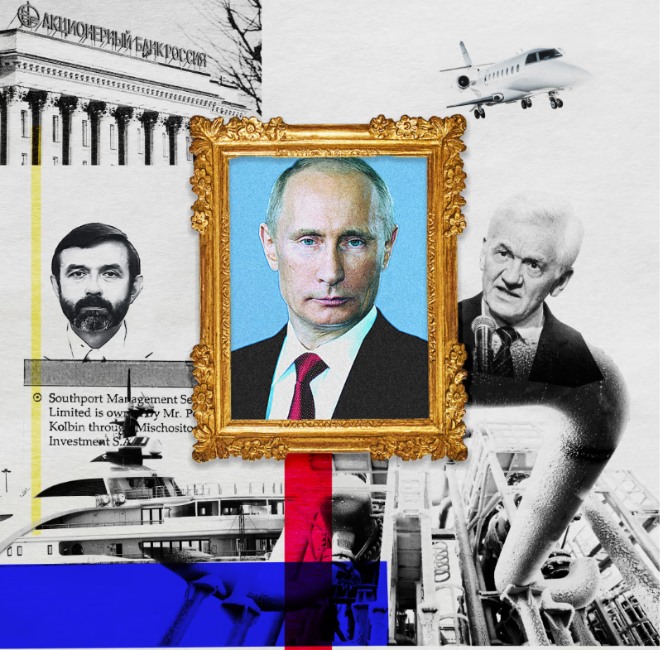
Cooking soup on Pandora papers: Recipe for tracking oligarchs’ assets
Minna Knus-Galán, Yle
Finnish Broadcasting
Company

Slide 2
Recipe for tracking oligarchs’ assets
Main ingredients
Cross border collaboration
Dataleaks
Databases
FOIA
Door knocking
Try to do the puzzle

Slide 3
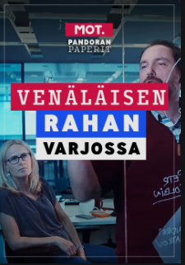
In the shadow
of Russian money
CASE 1
areena.yle.fi/1-50654062 (English subtitles)

Slide 4
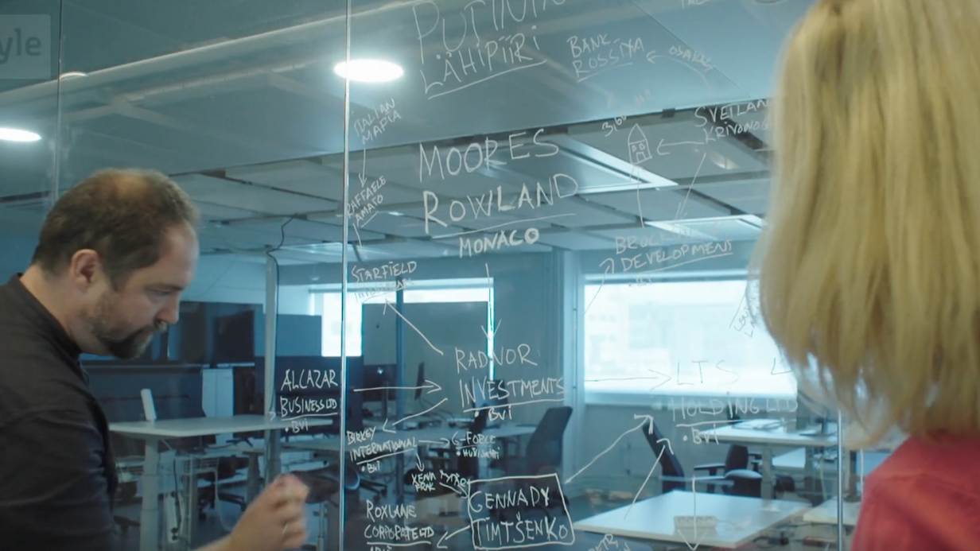

Slide 5
Huge dataleak
Learn the lingo
Understand the data
Team up with smarter colleagues
Train your sitting muscles -> no stories on a silver tray

Slide 6
Focus
Finnish-Russian oligarch Gennady Timchenko
Putin’s inner circle
Secret company hub in Monaco
A billion euro secret deal
Timchenko bought shares in strategically
important gas company Novatek

Slide 7
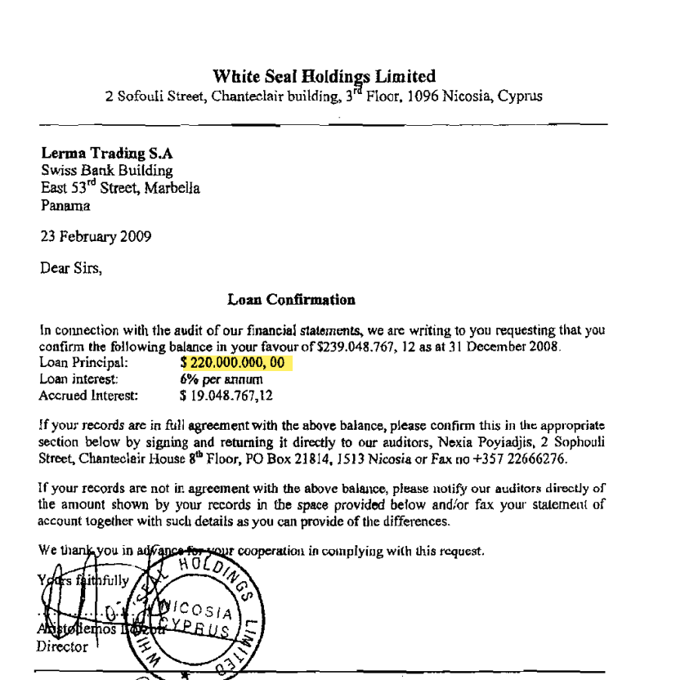
The leaked documents

Slide 8
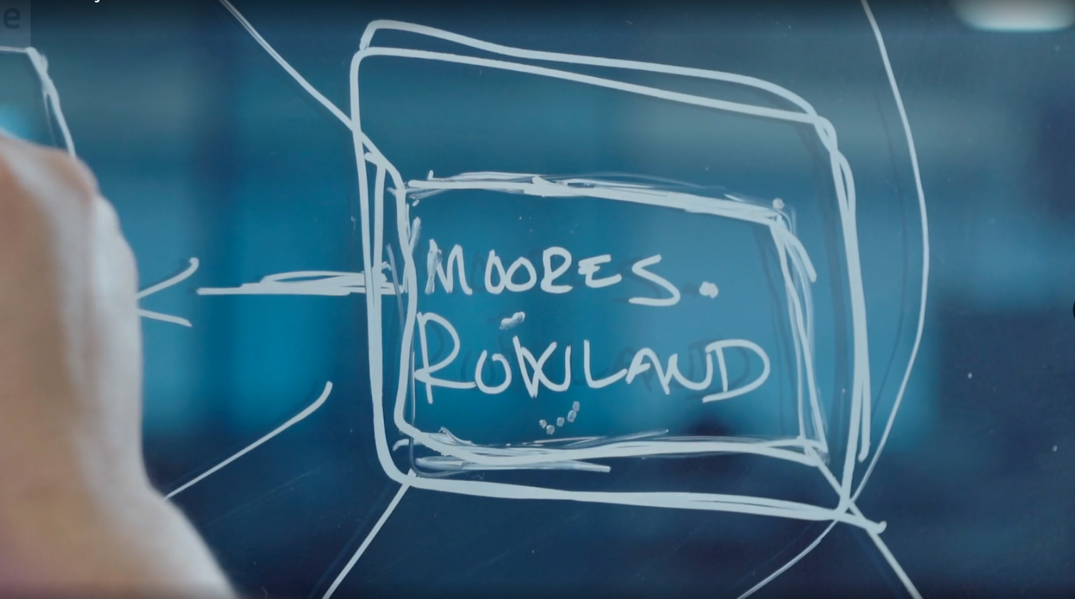
The puzzle
-try to find the pattern

Slide 9
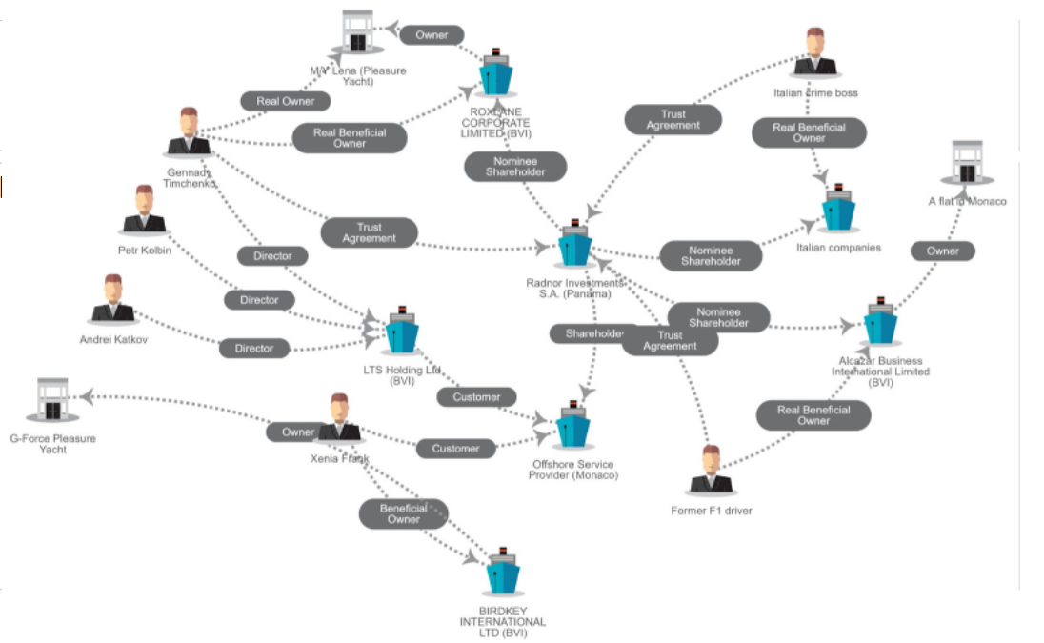

Slide 10
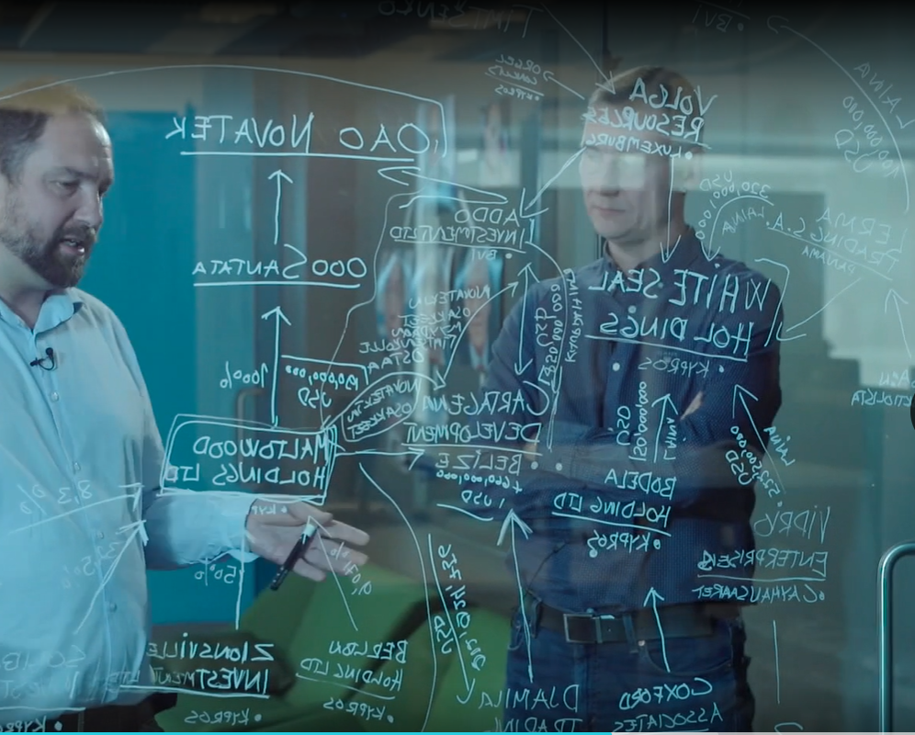

Slide 11
The collaboration -find colleagues researching the same topic

Slide 12
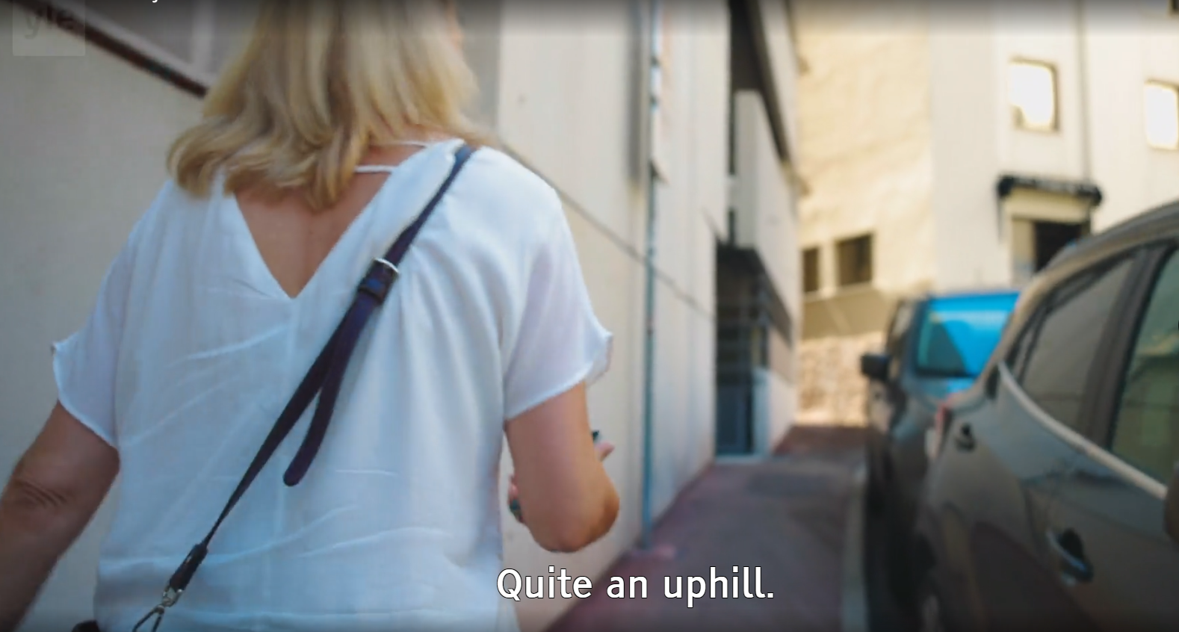
The location
-tell the story

Slide 13
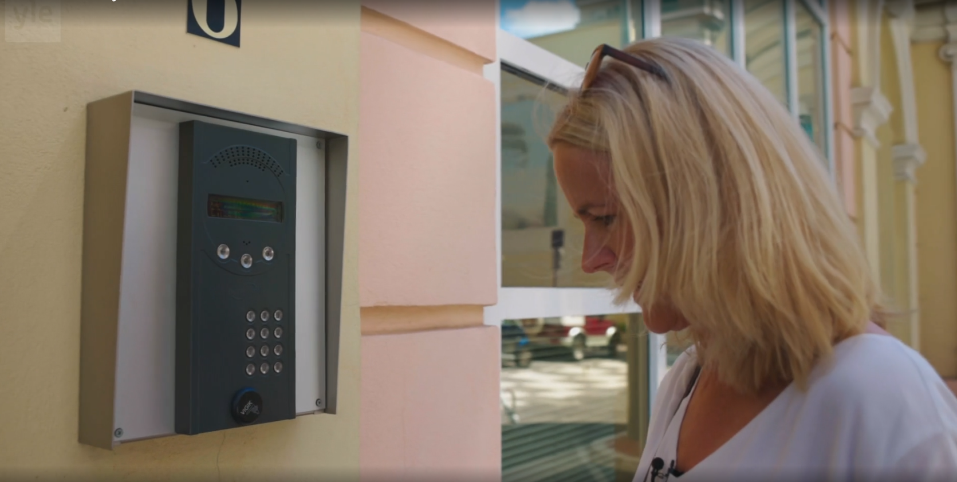
The door knocking
-traditional journalism
Notes:
confrontation interview

Slide 14
Open sources -documents and humans
Leaked documents are never enough
Court records
Business registries
Bankruptcy documents
Enforcement authorities (debts, seizures)
Tax authorities etc.

Slide 15
The sanction game
CASE 2
Another secret money stash of Putin’s inner circle
In Liechtenstein
Billions of euros
Bonus surprise

Slide 16
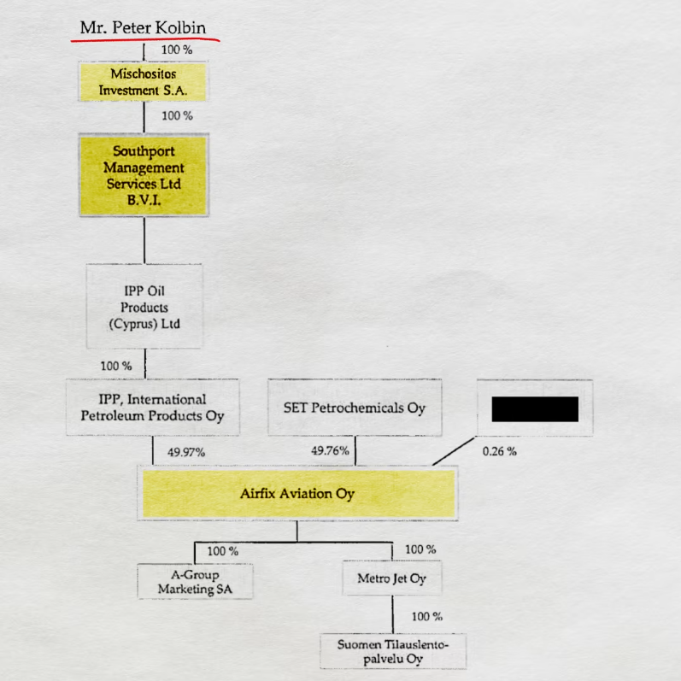
The court document
-this story begins with a public doc

Slide 17
Insignificant court case, important information
An insignificant court case in Finland.
Gennadi Timchenko’s Finnish aviation company was in court with a small minor company.
BUT they had to provide the real beneficial owners to the court. And we found that paper.
Two interesting names: the BVI company Mischositos Investment SA and it’s owner: Peter Kolbin. An unknown butcher from St Petersburg. In 2014 he suddenly becomes the owner of an aviation company that flies rich Russian oligarchs around the world. Why?

Slide 18
What happened 2014?
CASE 2
2014 Russia invaded Crimea
Timchenko was sanctioned
Moved his ownership of Airfix aviation to Kolbin -> typical hide and seek game of sanctions
Do a cronology -> understand the context

Slide 19
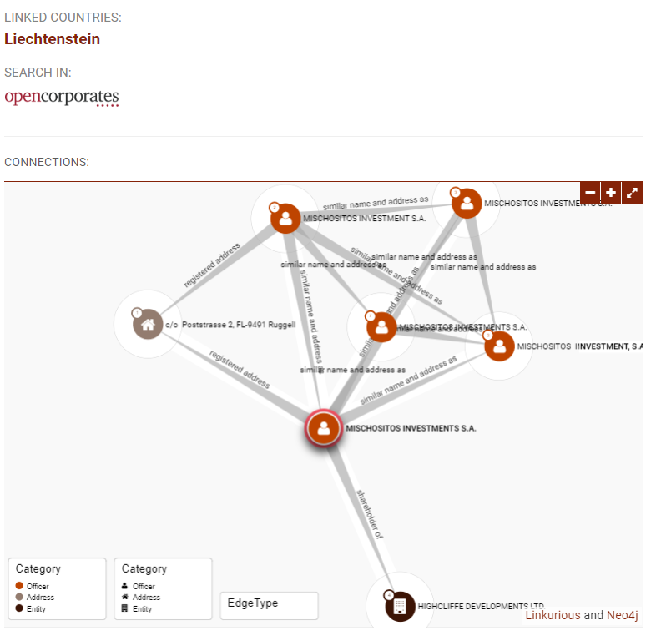
Mischositos investment SA in the Panama papers.
offshoreleaks.icij.org/
Excellent source by ICIJ since 2013
Which takes us to...
Notes:
Mischositos investment SA - a company found in the Panama papers. An excellent source is offshoreleaks data base that ICIJ has been building since 2013 with the first offshorelak ICIJ got. The leaked documents takes us…..

Slide 20
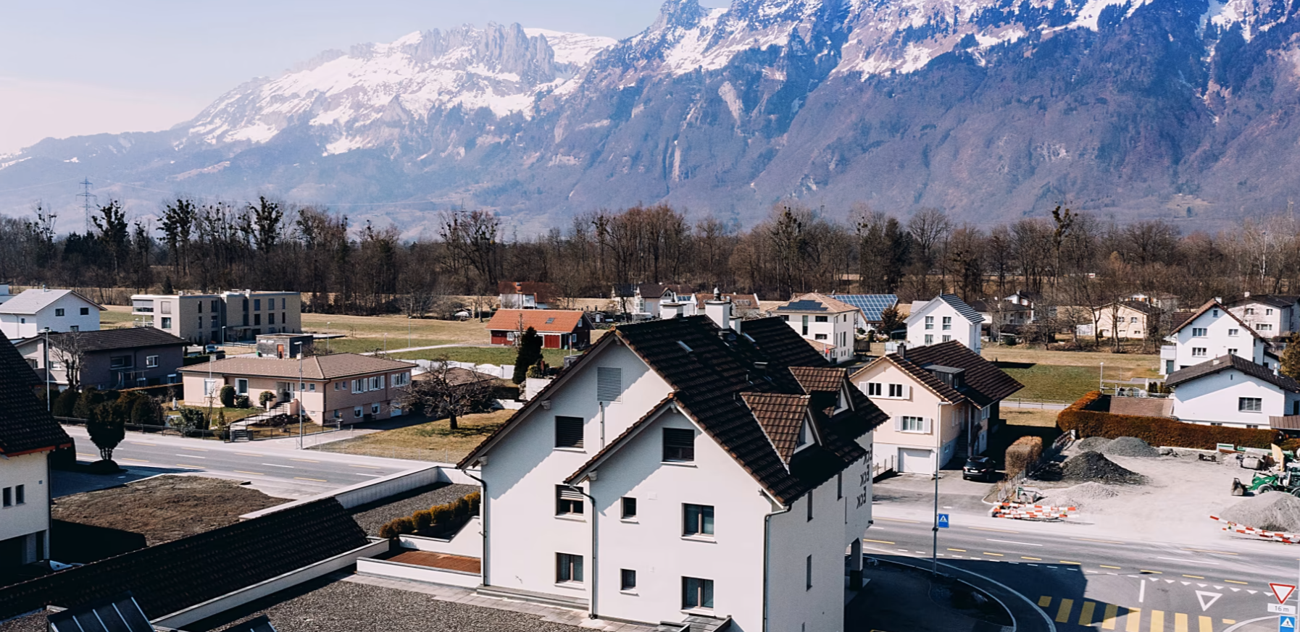
…tiny Liechtenstein. The offshore company was administered from this house in a small village, Ruggell. An offshore provider, a middleman which sets up and administers offshore companies around the world.

Slide 21
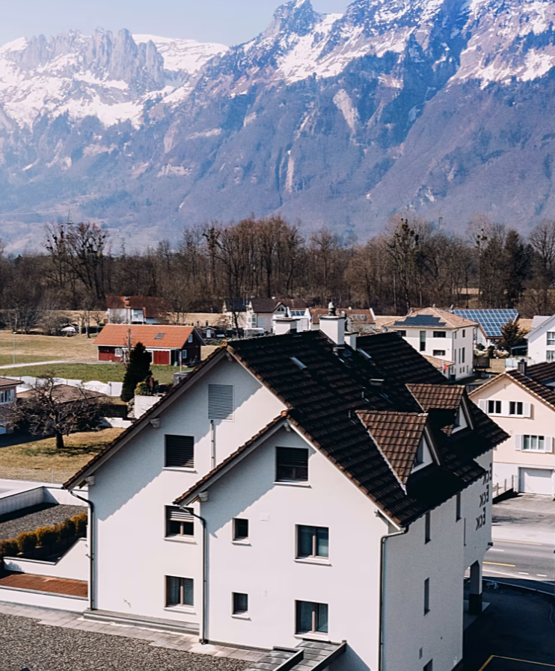
We found more
Hundreds of offshore companies
Billions of dollars of assets
And this…

Slide 22
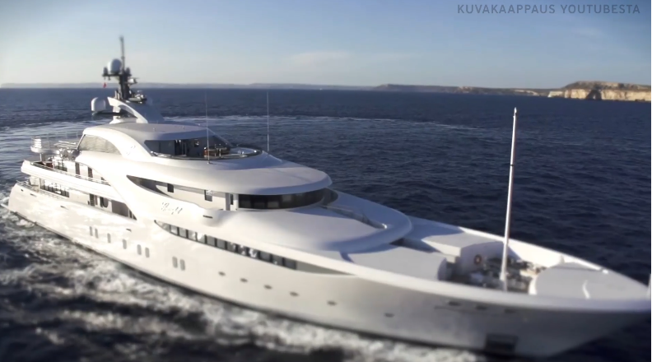
…Graceland, Putin’s yacht.

Slide 23
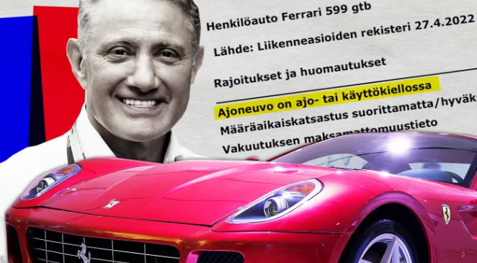
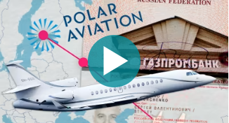
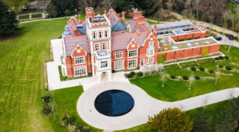
How to investigate seized assets of sanctioned persons?

Slide 24
How do you investigate seized assets of sanctioned persons?
FOIA: National Enforcement Authorities

Slide 25
BINGO!
We got all the decision!

Slide 26
SHIT!!
All names, companies and car registration numbers were hidden by authorities

Slide 27
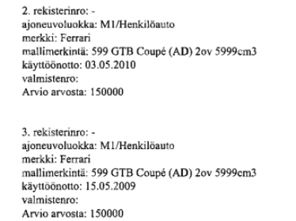
Case 1: Ferraris. The car registration number hidden

Slide 28
Don’t give up!
New FOIA to the car registry with the exact car model
We got the product number
With the product number we could go to the car registry database
There we got the owner….

Slide 29
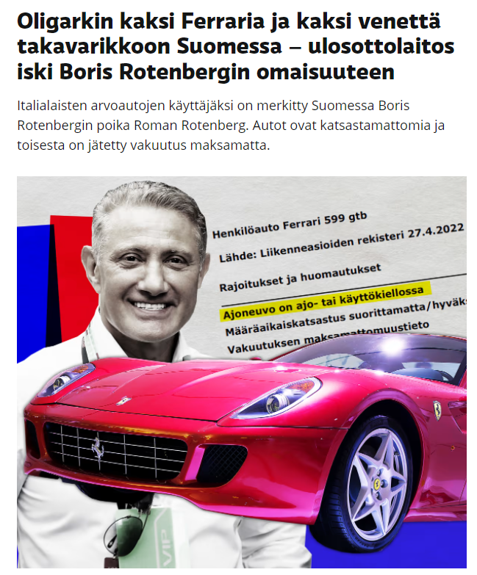
TADAAAA!!!
Owner is Boris Rotenberg, childhood friend of Putin.
We have a story!

Slide 30
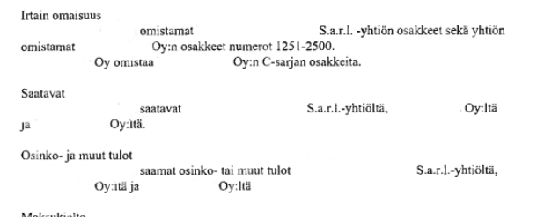
Case 2: seized shares in a company, name hidden by authorities

Slide 31
SARL -> French or Luxembourg company
The number of shares
My colleague happened to remember the number of shares
Timchenko’s shares of a big sports hall in Helsinki
Game of poker with the authorities -> get them to confirm

Slide 32
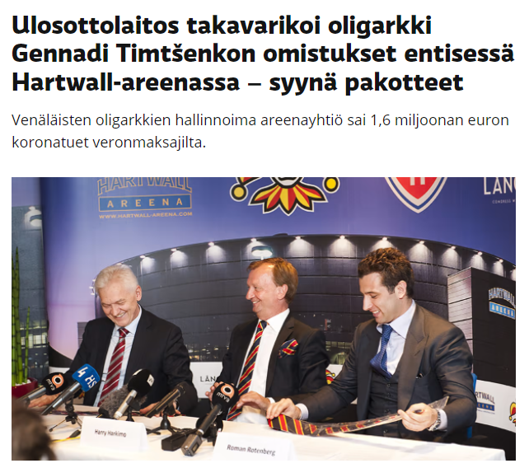
We have a new story!

Slide 33
Tips and tricks
Collaborate big or small
Team up with colleagues with different
Do FOIAs again, and again
Do a cronology - understand the context
Dataleaks is never enough - use open sources
Try to find the pattern
Get to know your databases
Think of getting information through the back door (case Ferrari)
Play poker games with the authorities
Don’t give up!

Slide 34
THANK YOU!
minna.knus@yle.fi
@minnaknus

