Slide 1
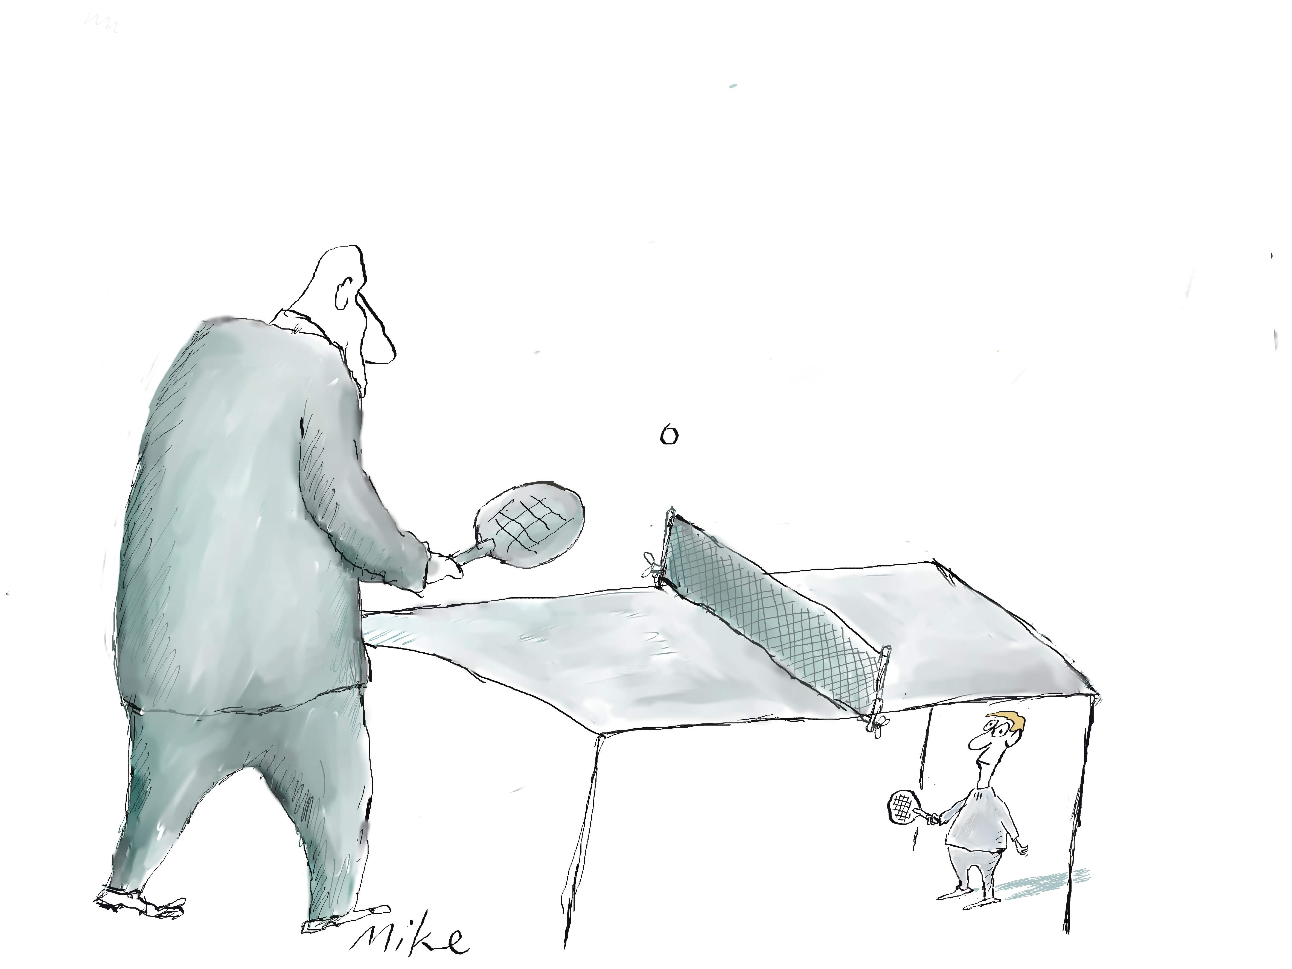
Even the odds. Have fun at work!
Local FOI tactics – and GDPR as a tool
Tarjei Leer-Salvesen, Fvn.no

Slide 2
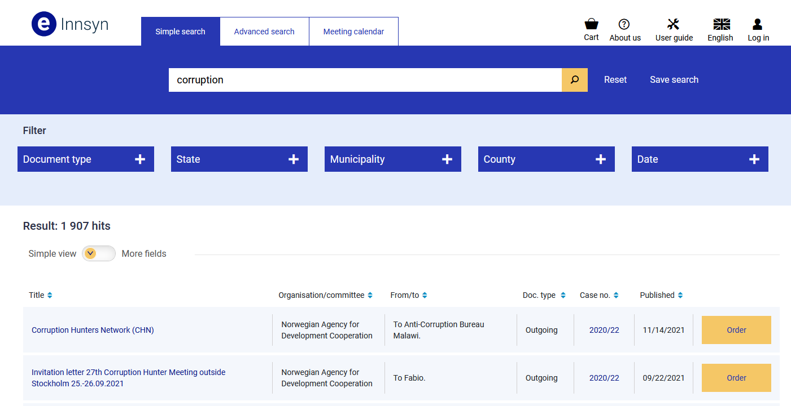
Norway’s FOI portal has metadata on actual documents

Slide 3
When you can browse metadata of documents, play wordgames
Breach
Compensation
Control inspection
Lawyer
Note on decision
Personell injury
Embesslement
Whistleblower
Suspicious
Thank you letter / medal award (military)

Slide 4
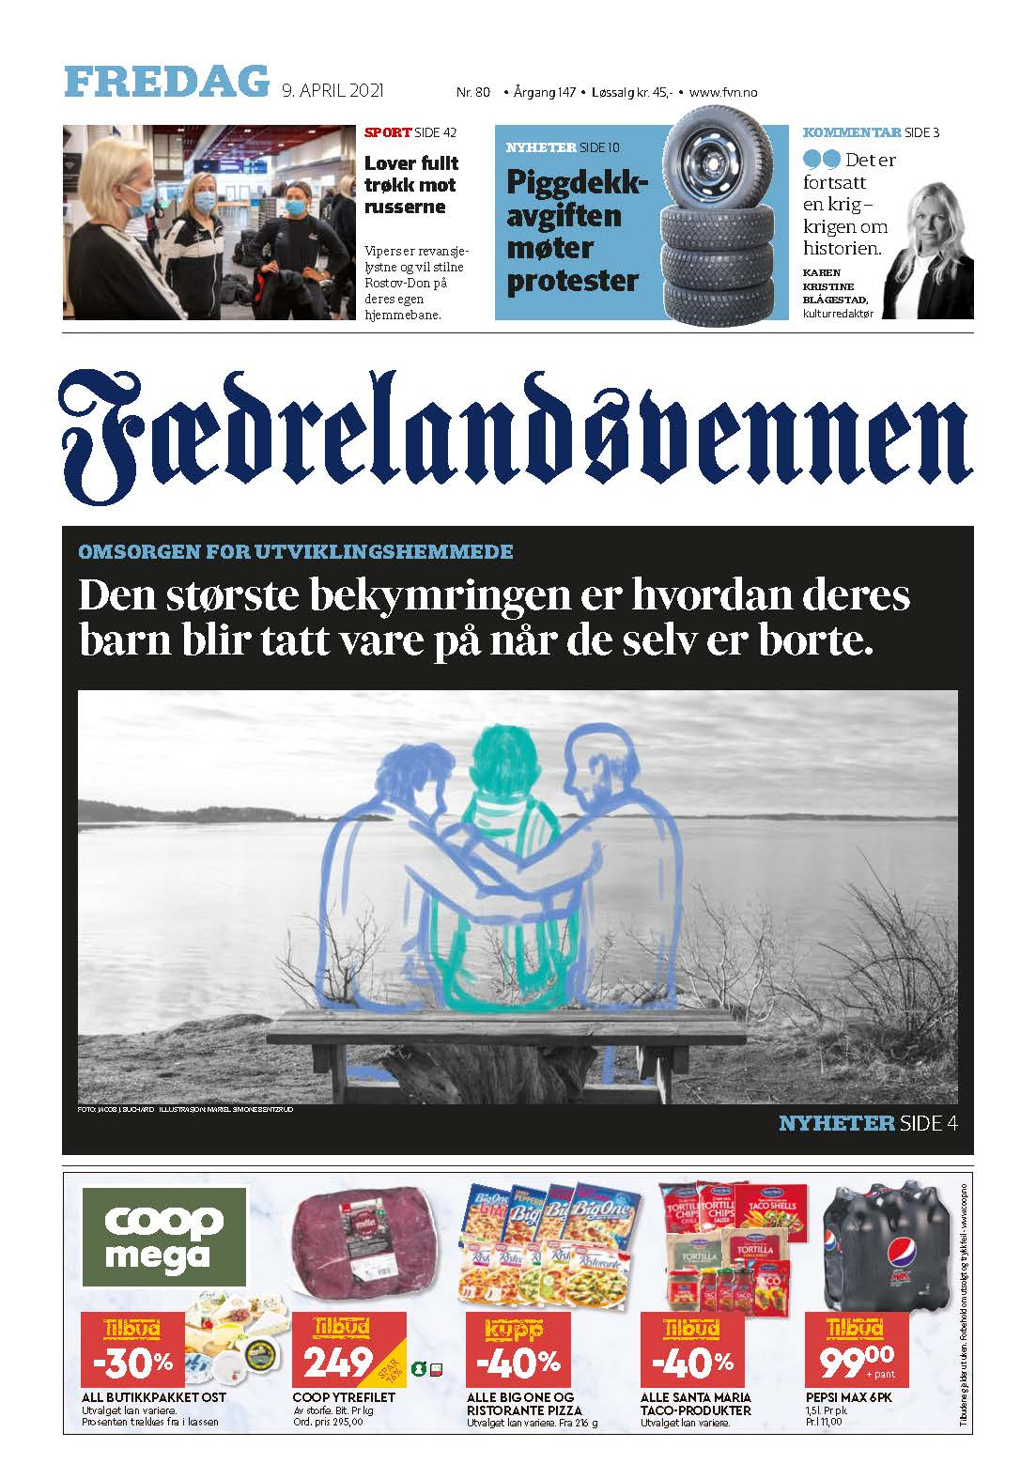
FOI routine
Browse lists,
ask for interesting docs

Slide 5
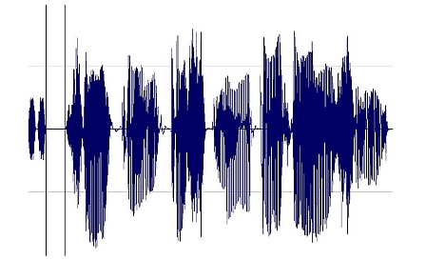
4. In our law, what is a document?
By «document» one means a limited amount of information, stored on a medium, for later reading, listening, projection, transfering or similar.

Slide 6
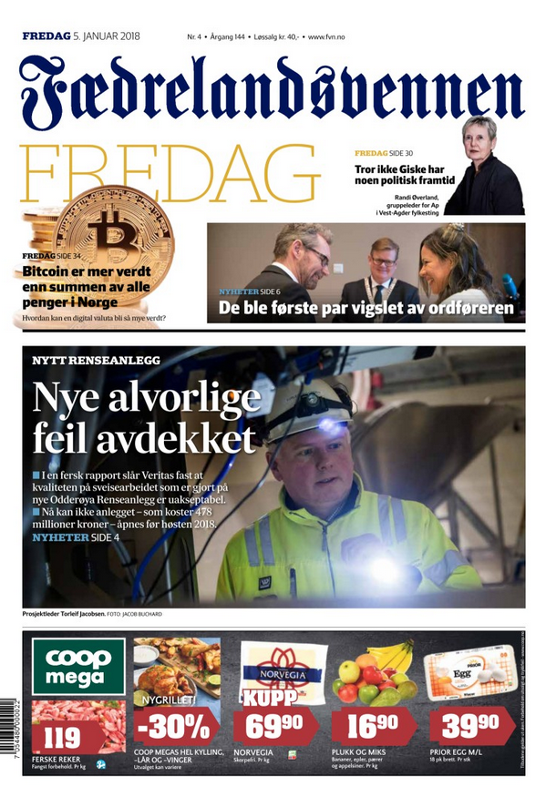
Trouble at the local sewer treatment plant
Did the workers who welded the pipes have welding sertificates?
What happens if something is wrong with the pipes?
Does the FOI Act give you right to see the results of an x-ray scan?

Slide 7
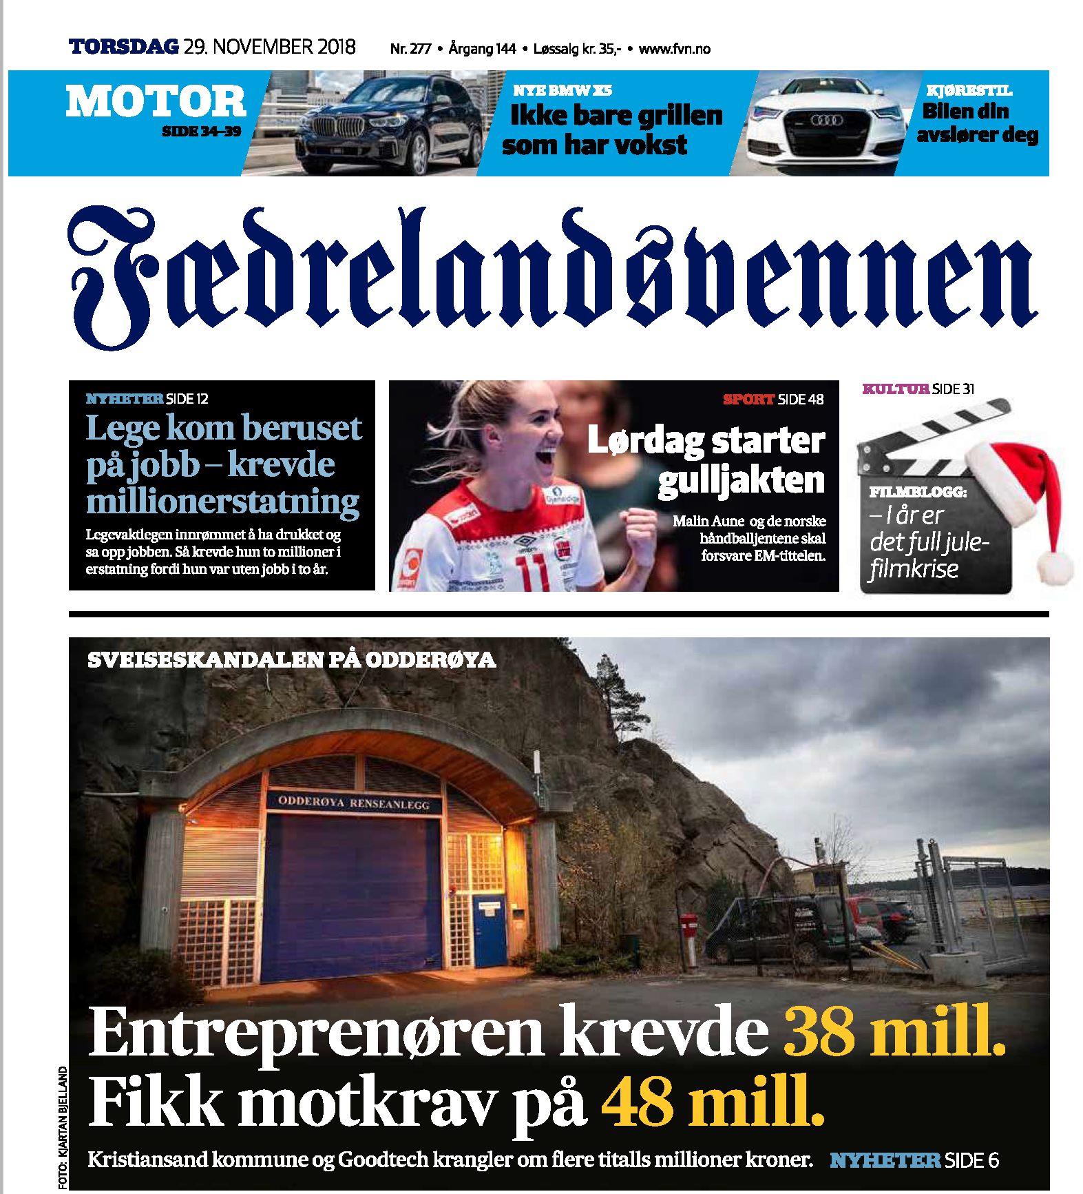
A case like this generates more stories
The welding company is bankrupt
A local company now cuts open, and then fixes every pipe and every welding seam
There are delays and huge costs

Slide 8
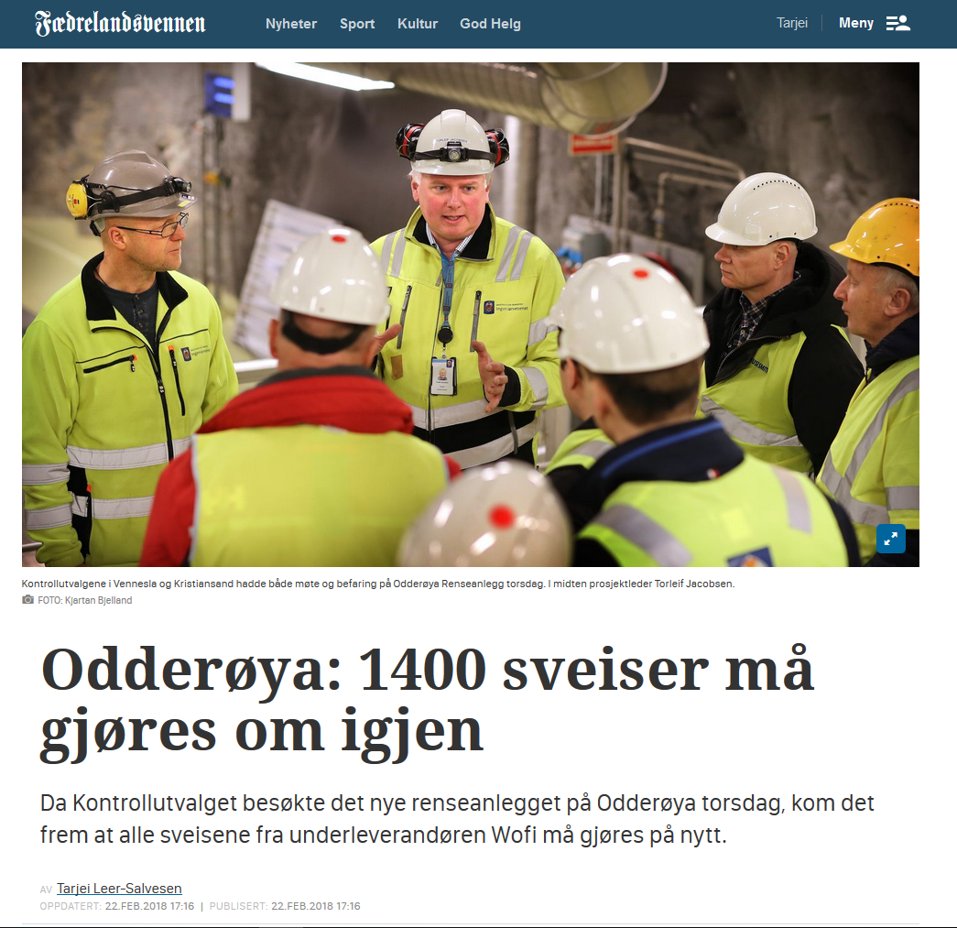

Slide 9
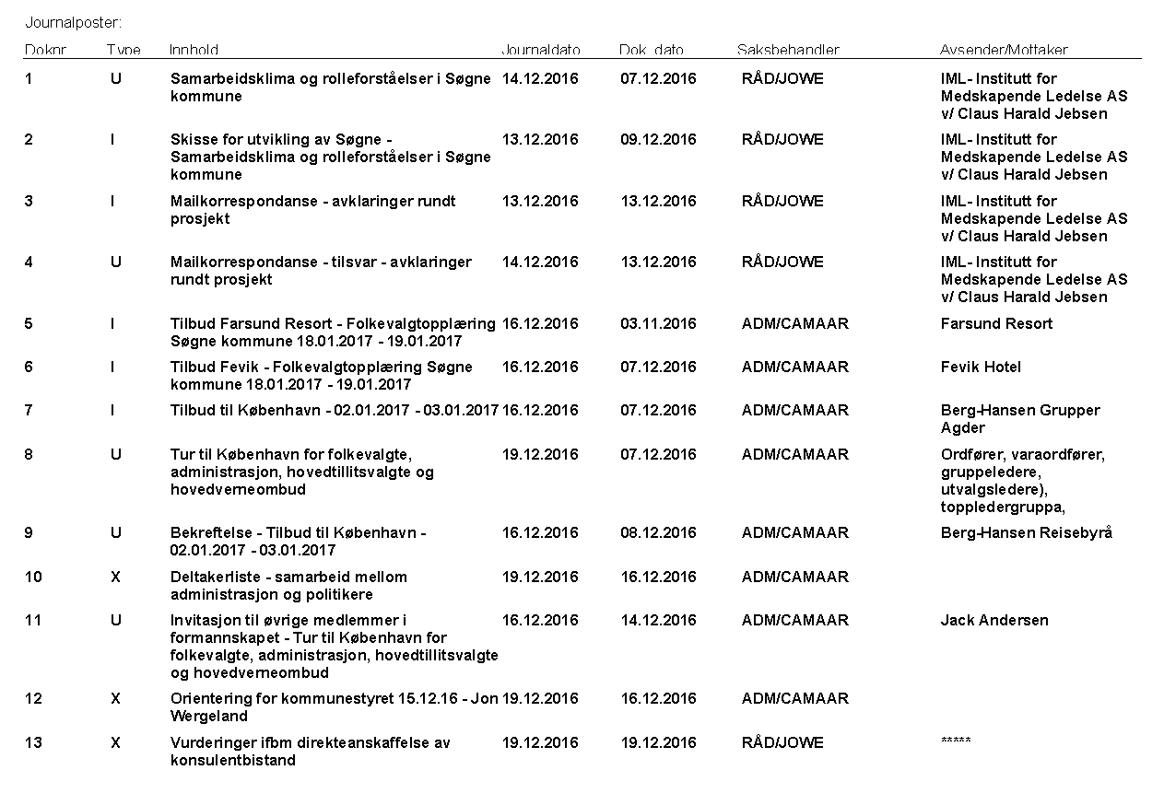
Ask for metadata.
FOI whole lists of documents.

Slide 10
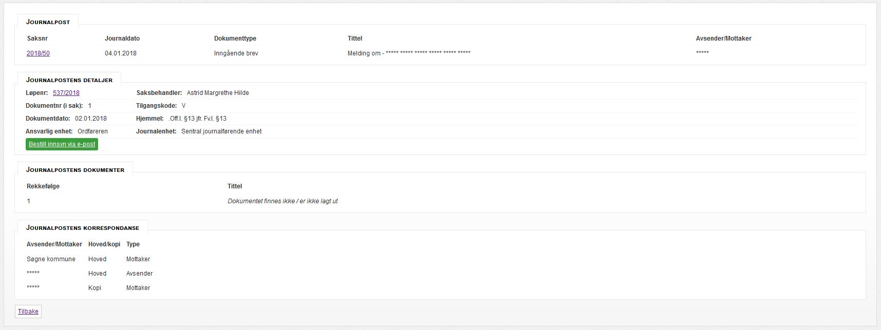
Learn archive language
This title is redacted, yet revealed in the metadata

Slide 11
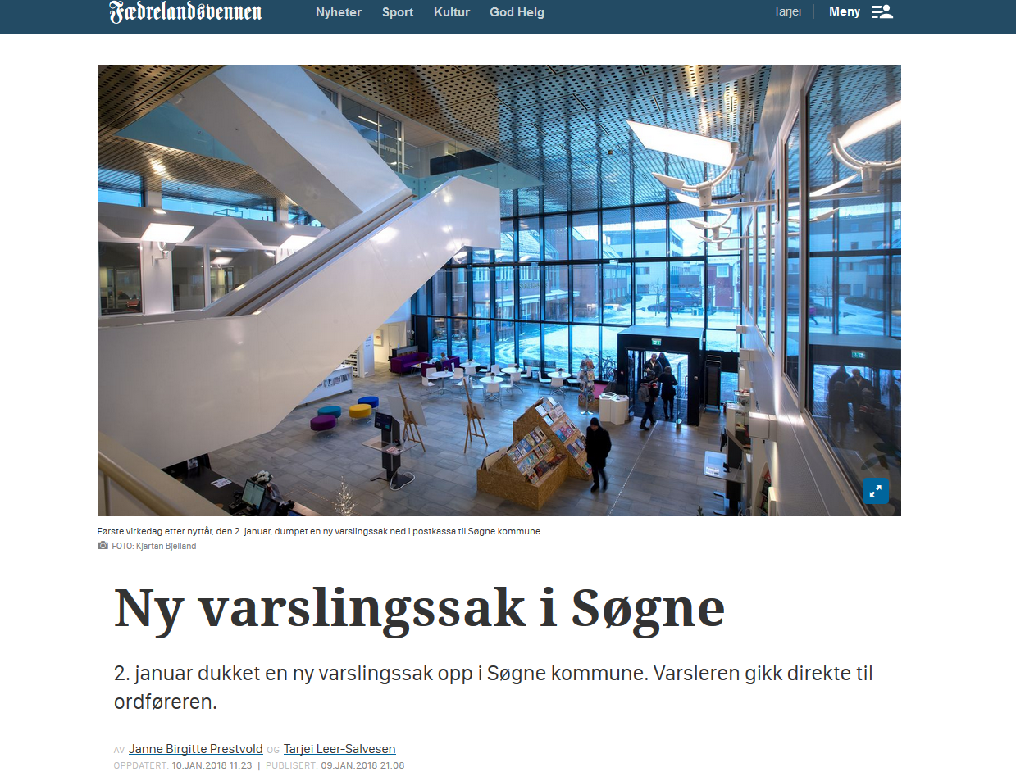

Slide 12
Søgne municipality
Ask for the list of «access codes» in the archives
Documents labelled V = whistleblower-cases

Slide 13
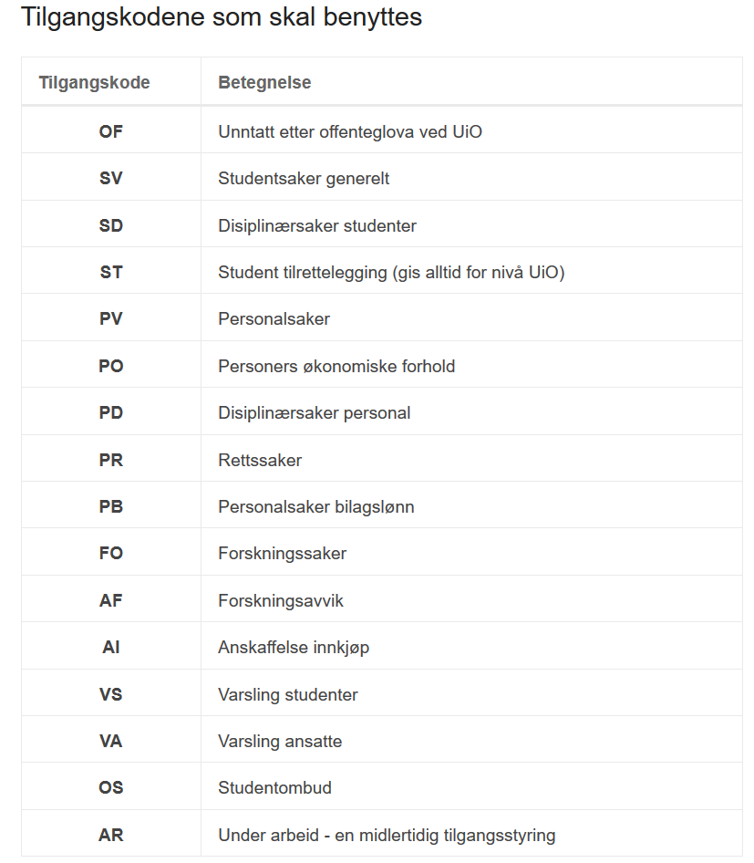
Oslo University
Documents labelled V = whistleblower-cases
- different for students and employees

Slide 14
What is multiple offices have the same letter, which of them must look at your FOI request?
You decide!

Slide 15
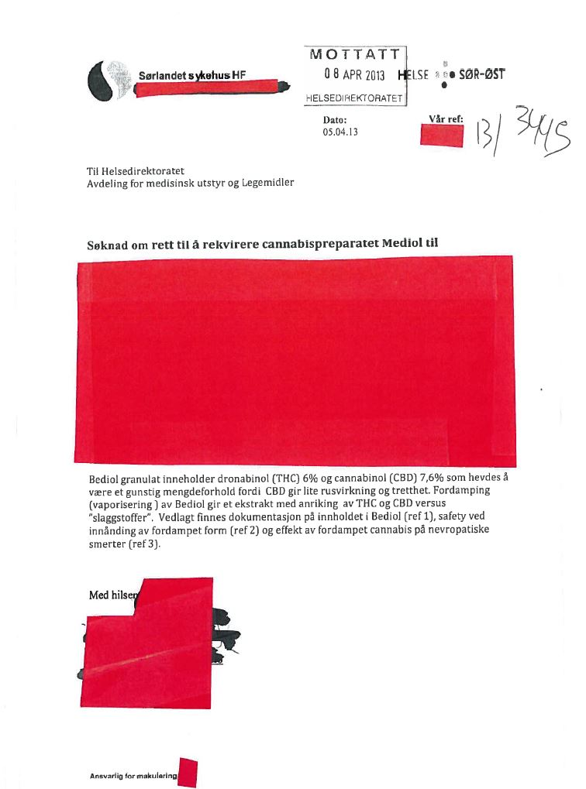
Learn how to appeal

Slide 20
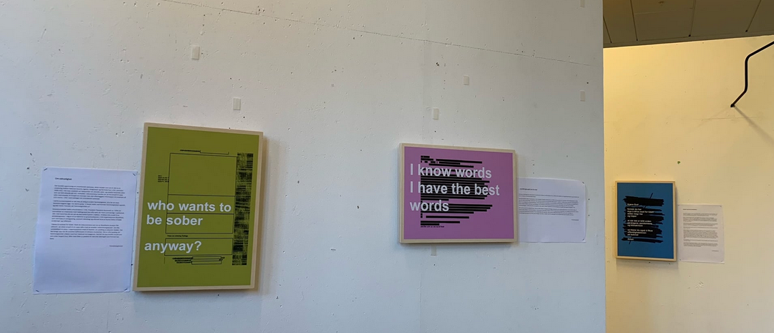
Law + humour is better than just the law
# forvaltningskunst
# officialsecretsart
Exhibition at
Kristiansand town hall
What did we learn?
Humour works!

Slide 21
Share experiences with colleagues
We have made templates for filing appeals on every paragraph used to deny a FOIA-request under Norwegian law.
Free download here:
http://presse.no/offentlighet/klag-pa-1-2-3

Slide 22
Innsyn etter personopplysningsloven
GDPR can be used as a research tool

Slide 23
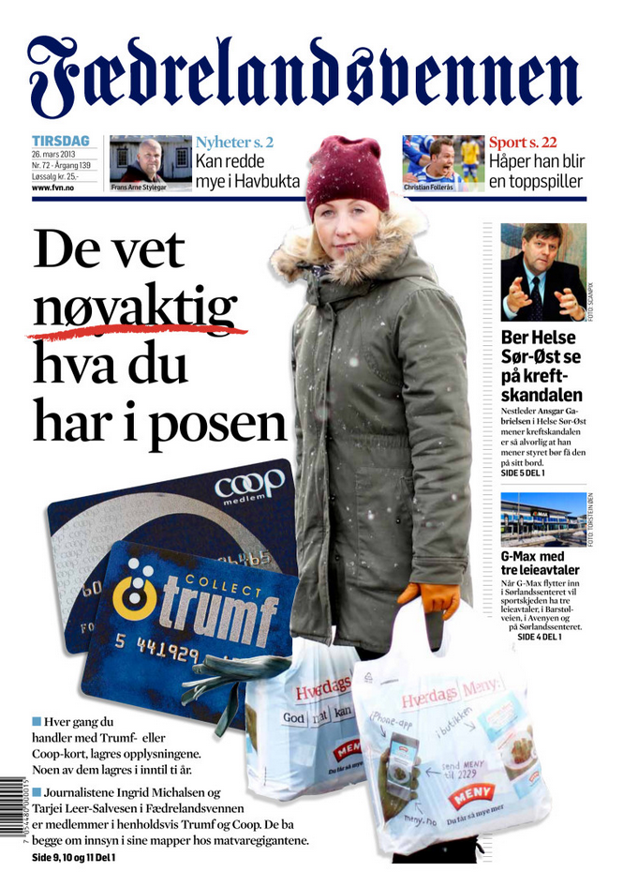
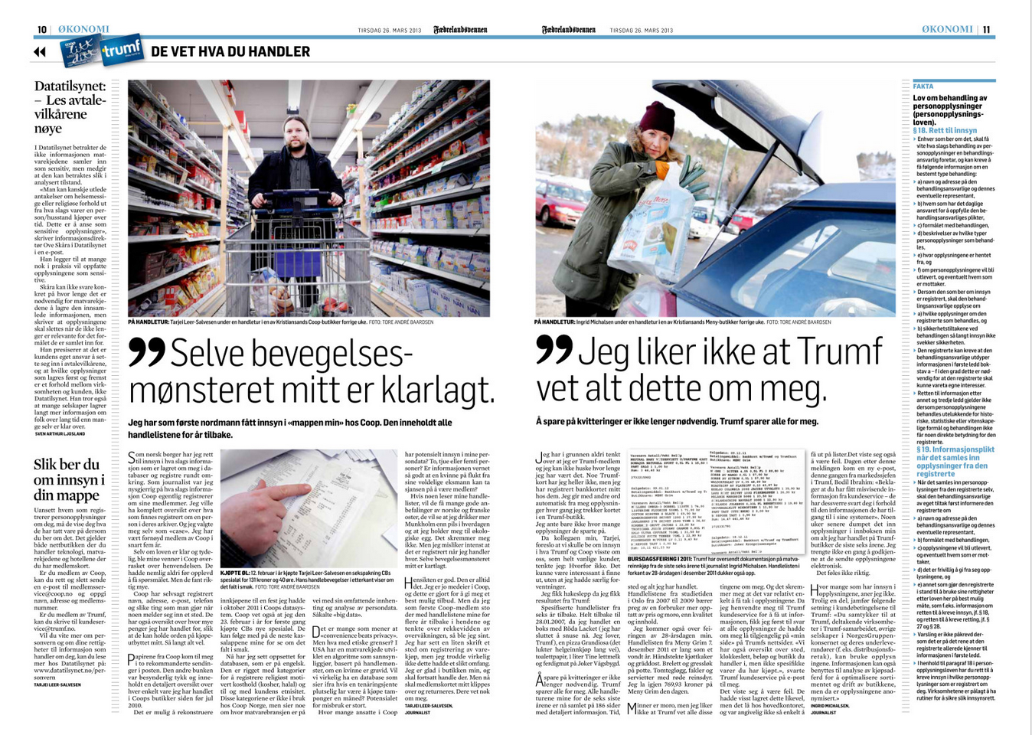
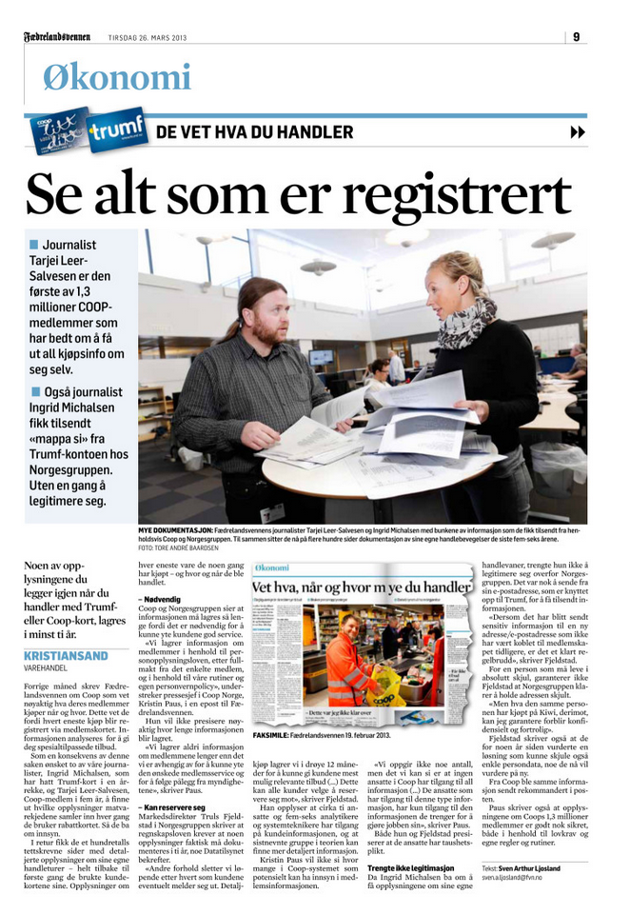

Slide 24
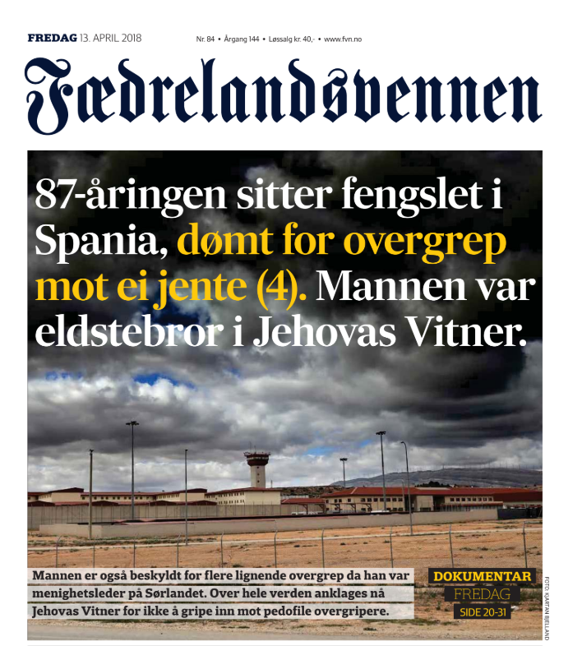

Slide 25
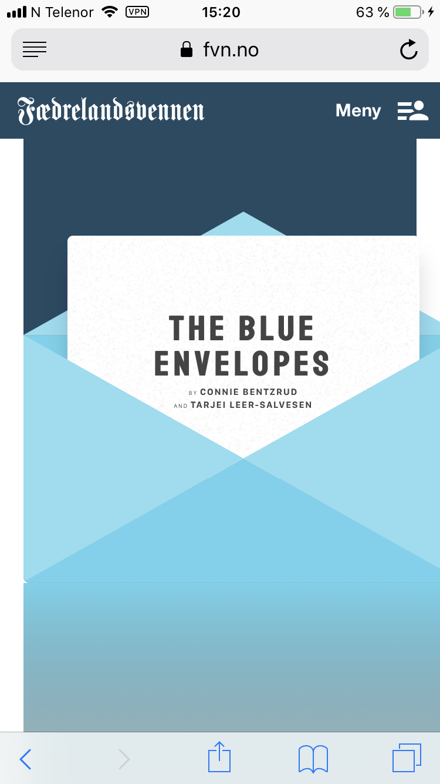
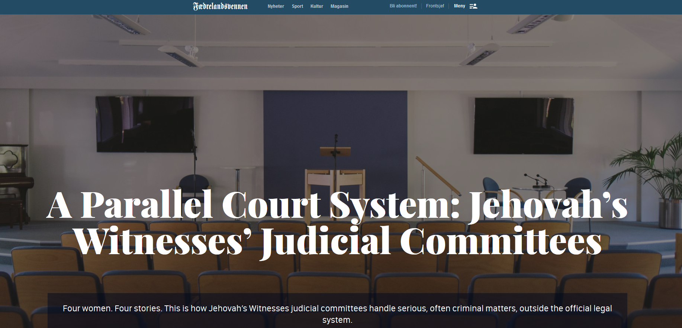

Slide 26
Don’t be shy. Ask for documents, but also for lists of documents and other metadata
Learn your rights to access information. You have more tools than the FOI law
Learn to file appeals
Check out the English interface at www.einnsyn.no – Norway’s FOI portal
Share experiences with colleagues (and competitors!)
Does more than one office have a copy of the document you were denied? File more FOI-requests
Learn archive language. And meet with the people in the archive!
Remember that GDPR can be a research tool if you combine FOI with source contact
Technical law understanding can bring you far. Add humour and source-contact, and you can fly
Have fun
Email: Tarjei.Leer-Salvesen@fvn.no Twitter:@tarjeils

