Slide 1

How to kill the planet and get away with it

Slide 2





From Lisbon to Genoa, Athens to the Arctic, an investigation into the shipping industry’s efforts to hide from climate change

Slide 3




An unknown culprit: Shipping
Started as a tip → Was the UN suppressing science?
Evolved into an explanatory reporting
A cross-border documentary project with EIC Network
Why documentary?
  Journalists experimenting
  Conveying urgency
Taking a leap of faith

Slide 4
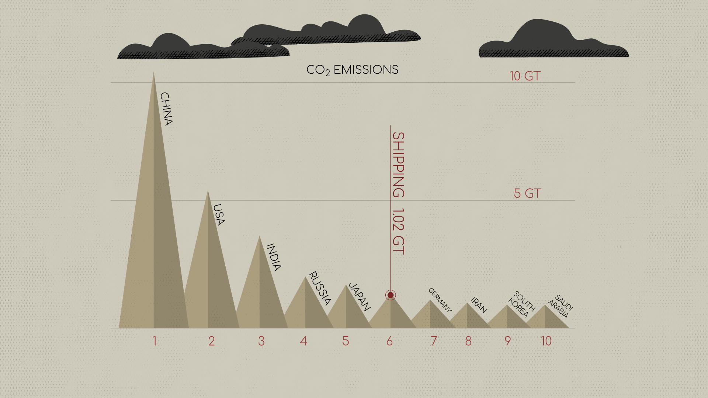
This is what made us say “wow”

Slide 5

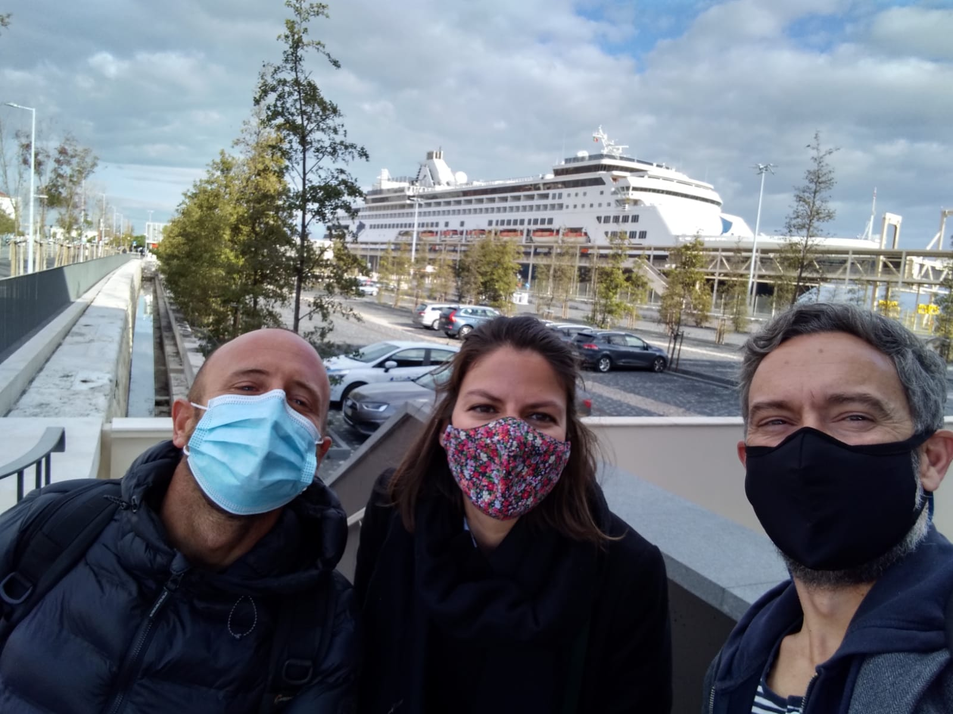
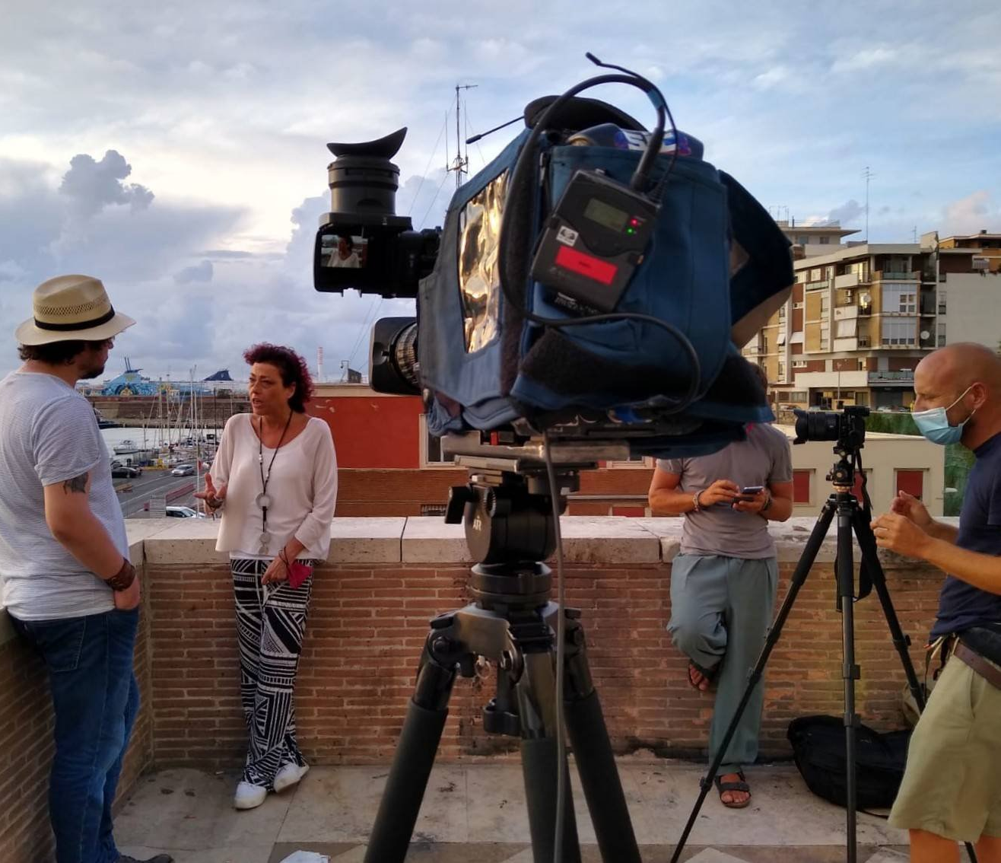
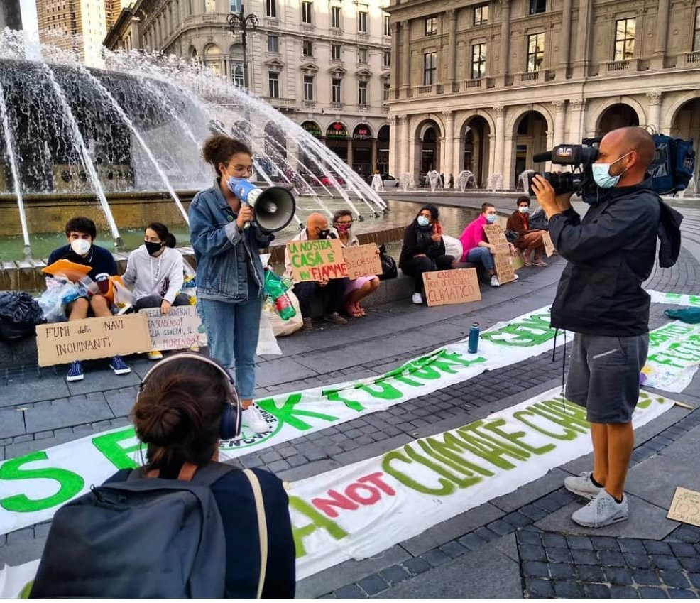
How did we do it?
In-depth research for months
Bracing for “the boring”
Talking to sources & agreeing to go on camera
Hitting the road
Overall: 9 reporters, 5 cameramen,15 months, many €€€s

Slide 6
Our Greek success
Can’t talk about shipping without talking about Greece
20% of the global, 50% of the Europe’s fleet
Major players on camera: how did we convince them?
Reporters United
  Experience in reporting on shipping
  Knowing the industry players well

Slide 7
What did we find?
A giant climate killer
An extreme source for pollutants in towns
A too rich & powerful, and now scared, industry
A captured regulator: IMO
A fed-up new generation
”Are you ready to stop the world trade?” - lobbyist
VS
“If you continue like this, there will be no countries to ship to” - activist

Slide 8

Shockingly underreported subject with a lot of potential for impactful stories

Slide 9
What could be the next story?
Pollution in port towns: major European cities
  Barcelona, Naples, Portsmouth, Hamburg, Rotterdam
Revolving doors
  Influence peddling, capturing institutions
Finding innovative story-telling ways
Riches of the industry
  Tax, tax, tax

Slide 10
Thank you!

Slide 11
Tax & shipping
”Quantifying tax subsidies to shipping” (2020)
OECD’s global tax regime
What was found
  Tax subsidy = revenues foregone for states
    2005–2019 revenue forgone: USD 38–69 billion.
  Effective tax rate for the shipping sector: 7%
  Cruise shipping: %0

