Slide 1
A Few Words About PowerPoint

Slide 2
Involve the audience •

Slide 3
One point per slide

Slide 4
Summarize it
Three simple, memorable points
Help you focus
Help the audience follow

Slide 5
Keep it short
Trying limiting your points to 3 or 4 words
Maybe use a picture instead of words.

Slide 6
Break it into chapters
Logical pieces are
easier to digest

Slide 7
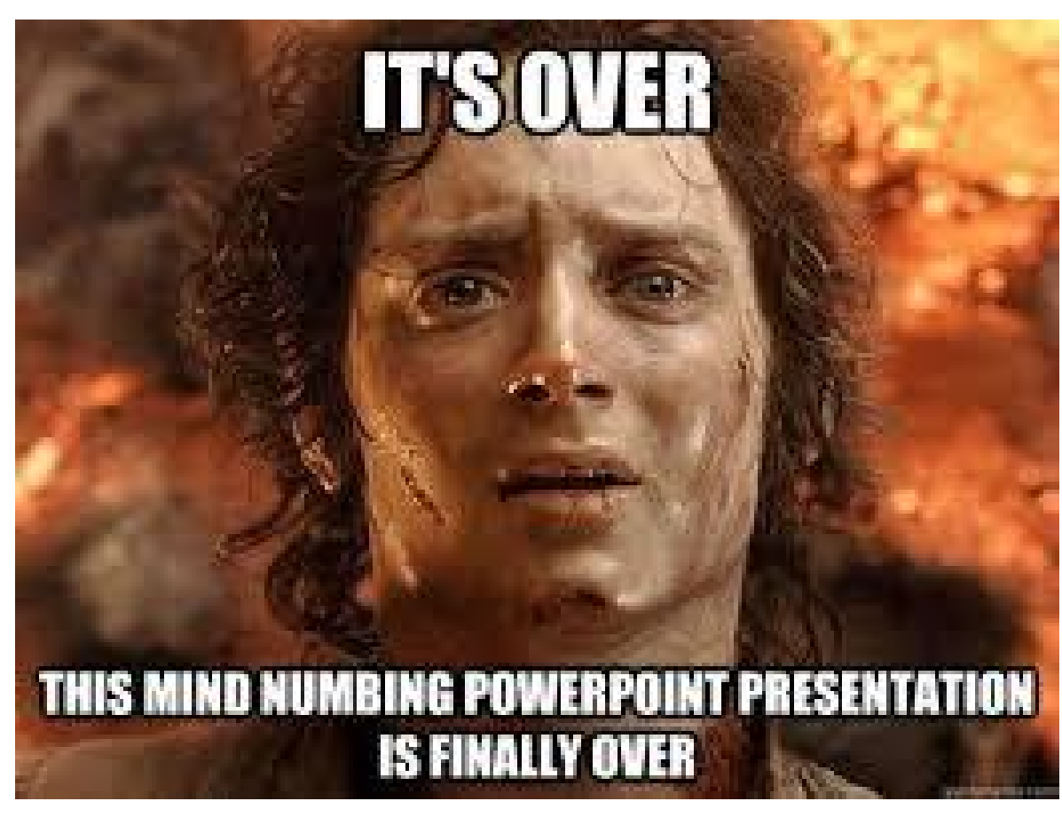
2 minutes a slide?
Each slide is worth about 2 minutes of talk.
This does NOT mean 10 slides give you a 20 minute talk
If you do it wrong, and write 17 slides, you are probably going to speak for about 30 minutes!

